Slide 1
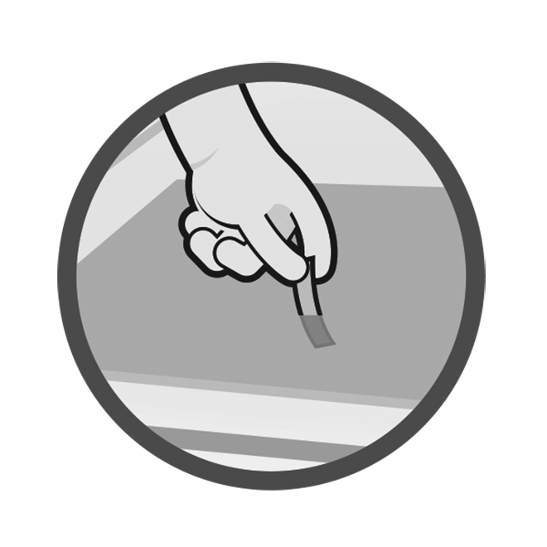
Sanitization for Food Safety
USING SANITIZER TEST STRIPS
Robert Lynch
Director of Sales and Technical Services
Micro Essential Laboratory
rob@microessentiallab.com
718-928-2913
Notes:
Welcome to Sanitization for Food Safety, on using sanitizer test kits! I am your instructor, ____________________.
Provide background information on who you are, where you are from, and why you are here.
First, I’d like to point out a few things:
1. Participant guide: Yours to keep, take notes, draw, doodle; includes course slides, a chart on choosing the correct sanitizer test kit, step-by-step instructions with images on using test kits, and Food Code references pointing out requirements for testing.
2. Parking lot: Large paper on the wall on which I will write down any questions you might have on a topic we are not currently covering; any questions I might not be able to answer so I can look up the answer for you; basically anything we can cover after the presentation, and don’t want to forget.
3. Practice stations: At the back of the room; practice what you learn here today for muscle memory; please remember, sanitizer is a potentially harmful chemical, so no horseplay.
4. Schedule: This is going to be approximately a 45 minute to one hour presentation, but I will stick around for another 10-15 minutes if you have any questions.
Before we look at the purpose behind bring you all here today, I’d like to share with you a quote that I found on an Amazon review of a product regarding the use of sanitizer test kits:
“Used at a restaurant. It’s great. We no longer “use” them, just have it around for the health inspector.”

Slide 2
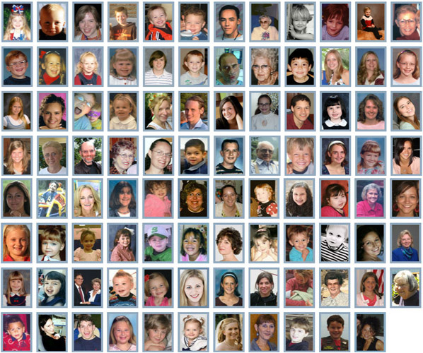
Honor Wall of real-life victims of foodborne illness. Stopfoodborneillness.org
Notes:
These are photos of just some of the people, associated with only one Website, StopFoodborneIllness.org, who have been affected by foodborne illness. This clearly represents that foodborne illness doesn’t discriminate on the basis of age, color, or gender. It can happen to anyone.
Has anyone here been involved with a foodborne illness case that resulted in a serious illness, or even death? What was the cause of the FBI? Could something have been done at the retail level to prevent the illness? Did it involve sanitization?
The goal here is to set the tone for the seriousness of FBIs in retail facilities and understand the PURPOSE for this training. If the participants have sufficient examples to share, that is the best scenario. If not, show the following 5 minute video.
This is why you all are here today – to understand that sanitizers and testing are crucial for keeping people safe. Someone needs to communicate the seriousness of improper sanitizer testing to the food facilities, and show them how to do it correctly.

Slide 3
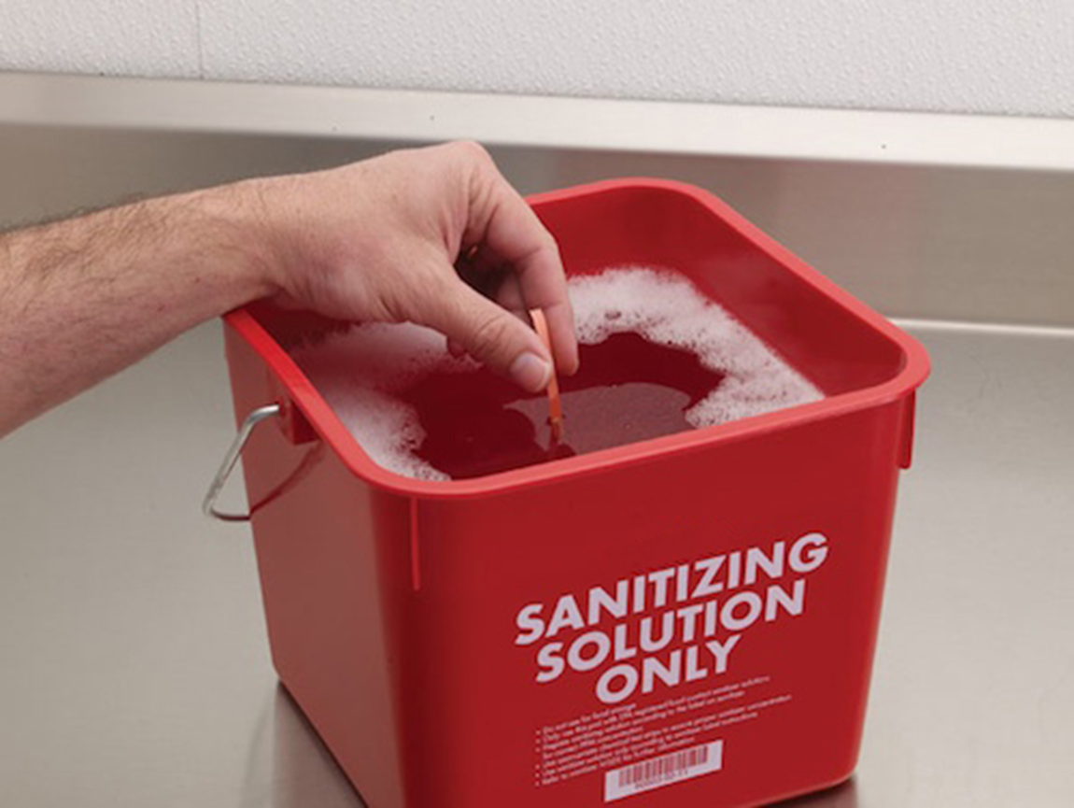
Welcome
TRAINING OUTLINE
The Who
The Why
The What
The Where
The When
The How
Notes:
Here’s a quick outline for our course. Today, we are going to discuss the who, what, where, why, when, and how of using sanitizer test kits.
The WHO is who we are, who you are, and who are we trying to help.
The WHY - WHY are we concerned about learning how to properly use sanitizer test kits anyway?
The WHAT will cover basic terms, what test kits to use, and talk about actually what it is that you’ll need to test.
The WHERE will provide a look at the locations and/or facilities that might require testing sanitizer solutions.
The WHEN will cover how often it is necessary to test, as well as discuss any potential differences in frequency between different sanitizer solutions or test kits.
Finally, the HOW. Just HOW do we use these test kits correctly? And have we really been doing it wrong the whole time? The answer to that is, we hope, no, but surprisingly more often than not, yes.
We’ll end the class with some hands-on practice and a quick assessment.
Sound good?
Before we begin - why are you here? Why did your boss, or regulator, or co-worker drag you to this training?
The overall goal of this training program – the reason you are here today – is to help you understand that correct sanitizer concentrations help keep people safe by minimizing microbial food safety hazards. Proper testing can prevent foodborne illness and protect people’s health. Hopefully, you will also learn something new.

Slide 4
The Who
Us: Micro Essential Laboratory, Inc..
The Regulator - Federal, State, Local
Industry - Retailers
Notes:
So, who are we, who are you, and who are we trying to help?
WHO are we, anyway, that we can talk to you about sanitizer test kits?
As I mentioned, my name is ___________________. Discuss your relationship with Micro Essential. This course is sponsored by Micro Essential Laboratory, Incorporated. Micro Essential Laboratory has been around since 1934 and is the leading manufacturer of sanitizer test paper used throughout the foodservice industry. They currently provide pH strips, sanitizer test papers, and pH buffer standards, along with various specialty test papers, to a global market.
And you know WHO you are - you are the health inspectors and regulators who we thought would be the best “in” to the front lines of food safety. We are obviously not able to visit every food establishment out there to ensure that people are using test kits correctly, but that is where you come in; that is part of what you already do when visiting a food establishment. As we already determined, not everyone in restaurants, retail, etc. knows how to use the test correctly, so we would like you to be comfortable enough to show them how to use it correctly. Ask the participants if anyone has any sanitization inspection stories to share with the class. Finding a sanitizer solution that had a concentration way off base? A cleaning bucket that actually didn’t contain any sanitizer? Employees who didn’t know where the test kit was, or worse, what a test kit was?
And WHO are we trying to help? The food establishment manager, the employee who is using that sanitizing solution to protect the public from foodborne illness, or any pathogens that might cause harm. Ultimately, through training, we’re all trying to protect the public.

Slide 5
The Why
To prevent, eliminate or reduce pathogens to a safe level.
To protect public health and prevent foodborne illness.
Regulations
Chemical sanitizers require minimum concentrations to ensure proper sanitization. (Food Code § 4-501.114)
Too much sanitizer could be toxic. (Food Code § 7-204.11)
Notes:
Federal, state and local health regulations require users of sanitizer solutions to have appropriate test kits available to verify the strength of sanitizer solutions. Note that the regulations DO require the users to USE the test kits, not only have them available. Again, this is where we need you all to help.
Testing kits to measure the concentration of sanitizing solutions are required for 2 reasons:
1. The use of chemical sanitizers requires minimum concentrations of the sanitizer during the final rinse step to ensure proper sanitization. AND
2. Too much sanitizer in the final rinse water could be toxic.
I have found employees will sometimes feel that if the recommended amount of concentrate in a set quantity of water is good, then adding a little more concentrate will make the solution last longer and will work better. Quite the contrary... using a sanitizer solution that is too strong can in fact put customers at risk since too strong a solution will actually contaminate the surface and potentially make the customer sick.
For your reference, a sanitizing solution that is too weak would be a violation of FDA Food Code § 4-501.114. A solution that is too strong would be a violation of § 7-204.11.
What about your local jurisdiction? Does anyone follow regulations different than those from the latest Food Code?

Slide 6
The What
Cleaning-the removal of dirt, food, or other soil from a surface, usually accomplished by a detergent
Sanitizing-the removal of pathogens to a safe level, defined as a 5-log reduction, or removal of 99.999% of organisms.
Sanitizing only works when it follows
proper cleaning!!
Notes:
Before we can talk about WHAT it is we’re trying to accomplish, we need to make sure that everyone understands the terminology associated with food safety sanitization. This will be review for many of you, yet correct definitions are important in our discussion.
Cleaning and sanitizing are two very important, and very different, terms that are used in food safety.
Cleaning refers to the removal of dirt, food, or other soil from a surface, usually accomplished by a detergent.
Sanitizing refers to the removal of pathogens to a safe level, defined as a 5-log reduction, or removal of 99.999% of organisms. Cleaning alone is not sufficient for food contact surfaces, and sanitizing only works when it follows proper cleaning.
What other terms are important when discussing food safety sanitization?
If the participants seem knowledgeable in the terms, the next page can be read to them as fill-in-the-blank for more interaction and/or to keep them engaged.

Slide 7
The What
Disinfection- eliminates nearly all recognized pathogenic microorganisms but not necessarily all microbial forms (e.g., bacterial spores) on inanimate objects.
Sterilization- is a procedure that kills all microorganisms, including high numbers of bacterial endospores. Sterilization can be accomplished by heat, ethylene oxide gas, hydrogen peroxide gas, plasma, ozone, and radiation (in industry).
Notes:
Disinfection: eliminates nearly all recognized pathogenic microorganisms but not necessarily all microbial forms (e.g., bacterial spores) on inanimate objects.
Disinfection is used to decontaminate items. The primary objective of decontamination is to reduce the level of microbial contamination so that infection transmission is eliminated; decontamination renders an area, device, item, or material safe to handle (i.e., safe in the context of being reasonably free from a risk of disease transmission).
Sterilization: is a procedure that kills all microorganisms, including high numbers of bacterial endospores. Sterilization can be accomplished by heat, ethylene oxide gas, hydrogen peroxide gas, plasma, ozone, and radiation (in industry).

Slide 8
The What
Temperature Sanitization (Heat Sanitizing) in retail food facilities is accomplished by:
Hot water manual operations by immersion at temperature of 171°F (77°C) for at least 30 seconds.
Hot water mechanical operations by being cycled through conveyor warewashing equipment at a temperature of 180°F (82°C.). This manifold temperature which will yield a plate temperature of 160°F or above.
Notes:
Temperature Sanitization: in retail food facilities is accomplished by:
Hot water manual operations by immersion at temperature of 171°F (77°C) for at least 30 seconds.
Hot water mechanical operations by being cycled through warewashing equipment at a temperature of 180°F (82°C.)
Conveyor machines require a 180F manifold temperature to yield a 160F plate temperature.
Stationary machines require 165F manifold to yield a 160F plate temperature.

Slide 9
The What
Chemical Sanitization- Manual or Mechanical
Chlorine
Quaternary Ammonium Compounds (Quats)
Iodine
Other
Notes:
Chemical Sanitization: is accomplished by:
Chemical manual or mechanical operations, including the application of sanitizing chemicals by immersion, manual swabbing, brushing, or pressure spraying methods.
In order for sanitization to be effective, sanitizers need to be in contact with the equipment or surface for a sufficient amount of time, called the contact time, as specified on the sanitizer label.
And finally we have chlorine and quats, the most common food contact surface sanitizers, that we’ll discuss in more detail. Others that you may find include iodine and peracetic, or peroxyacetic, acid (PAA.)

Slide 10
The What
CHLORINE
Concentration Range (ppm) | Minimum Temperature pH 10 or less | Minimum Temperature pH 8 or less
25-49 | 120◦F (49◦C) | 120◦F (49◦C)
50-99 | 100◦F (38◦C) | 75◦F (24◦C)
100 | 55◦F (13◦C) | 55◦F (13◦C)
Notes:
First, Chlorine: Chlorine compounds generally used in food surface sanitization are calcium and sodium hypochloride. The solution must have a minimum temperature based on the concentration and PH of the solution as listed in this chart.
You have all seen this chart before:
Go over the slide
Does anyone know WHY chlorine is affected by pH?
As pH increases, chlorine becomes less effective as a sanitizer. Chlorine itself is a strong base – has a high pH. If the pH of the solution is high, chlorine won’t “react.” It takes a lower pH, more of an acidic environment, to get the chlorine to react in the water and actually do what we want it to do; that is, sanitize.
While chlorine is effective for most bacteria, viruses, fungi, and bacterial spores, chlorine is not the best choice to breakdown organic matter and biofilms (groups of microbial cells held together by a kind of cellulose; basically microbial slime). Those require scrubbing, acidic cleansers, and quats.

Slide 11
The What
As pH increases, chlorine becomes less effective as a sanitizer.
Chlorine itself is a strong base – has a high pH ( 7 – 14)
If the pH of the solution is high or basic, chlorine won’t “react.”
It takes a lower pH, more of an acidic environment, to get the chlorine to react in the water and actually do what we want it to do; that is, sanitize.

Slide 12
The What
Chlorine
IS effective for most bacteria, viruses, fungi, and bacterial spores
IS NOT the best choice to breakdown organic matter and biofilms (groups of microbial cells held together by a kind of cellulose; basically microbial slime). These require scrubbing, acidic cleansers, and quats.

Slide 13
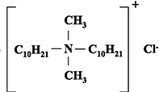
The What
QUATERNARY AMMONIUM COMPOUNDS
Surfactant and Sanitizer
2-Chain quats
Shorter chain
Second generation
Exact measurement, 200ppm
4-chain quats
Longer chain
Fourth generation
Broad range of measurement, 150-400ppm
Notes:
Quats: Quaternary Ammonium Compounds.
Does anyone know the difference between quats? Did anyone even know that there were different types of quats?
First of all, quats are surfactants as well as sanitizers. Does anyone know what a surfactant is? A surfactant is the reason that detergents work. It is a chemical compound that lowers the surface tension of water, making it easier for water to “stick” to a substance. That, in turn, makes the surface itself more readily available for cleaning.
The 2 types of quats used in food safety sanitization are 2-chain and 4-chain quats. The number represents the number of “chains” coming off of the central nitrogen atom as shown in the following diagrams, and can be written in many forms.
Read over info on slide for each one. Images are only examples of one type of 2-chain or 4-chain quat. See FAQs for more details.

Slide 14
The What
QUATS MUST:
Be tested at a temperature of 65°F - 75°F (18°C - 24°C) for greatest accuracy (this may not be the same as the “use” temperature.)
Have a concentration as specified under the FDA Food Code § 7-204.11 and as indicated by the manufacturer’s use directions included in the labeling
Be used only in water with 500 MG/L hardness or less or in water having a hardness no greater than specified by the EPA-registered label use instructions because the surfactant makes the quat more sensitive to water hardness levels.
Notes:
A quaternary ammonium compound solution must:
Read the slide – again if the participants seem to be knowledgeable or want more interaction, pull out parts of the statements and ask for their input and/or answers.
The way that the surfactant works, makes the quat sensitive to water hardness levels.
If a facility is on a municipal water system, the water supplier can provide you the hardness level of the water they deliver. If there is a private water supply, the water can be tested for hardness. Water that is above the 500 MD/L hardness-level may be treated with a water-softening system to reach appropriate levels.

Slide 15
The What
QUAT BINDING:
If a cloth is soaking in solution, there may not be enough sanitizer for it to be effective in reducing the number of pathogens.
Quats bind to fabrics (microfiber cloths bind less than cotton)
Sanitizer is “in the fabric” no longer in the solution
Leads to an ineffective level of sanitization on the surface/equipment
The Quat solution need to be tested just prior to use
Notes:
Quat binding is also an issue that needs to be recognized.
The sanitizing component in the quat is attracted to and absorbed in to fabrics. This happens when a cleaning cloth is left soaking in a quat solution.
The results is that the quat meant to sanitize a surface does not actually end up on that surface, but “bound” in the cloth. One study found that the level of sanitization decreased by 50% after soaking for just 10 minutes.
If a cloth is soaking in solution, there may not be enough sanitizer for it to be effective in reducing the number of pathogens.
Microfiber cloths tend to have less quat binding than cotton.

Slide 16
The What
When using quats, it is important to …
Spray, wipe around lightly and air-dry,
dip and air-dry, or
soak an item to be sanitized in a solution that has been tested and confirmed to be at the correct concentration. Then air-dry.
Notes:
Therefore, when using quats, it is important to spray and wipe, dip and wipe, or soak an item to be sanitized in a solution that has been tested and confirmed to be at the correct concentration.

Slide 17
The What
SOLUTION | PROS | CONS
Chlorine | Highly effective on a wide variety of bacteria, inexpensive, and not affected by water hardness | Corrosive and irritating to the skin, effectiveness depends on solution pH and exposure to light; loses effectiveness with biofilms/organic matter, requiring more frequent water changes
Quats | Nontoxic, odorless, colorless, noncorrosive, nonirritating, effective over a wide pH range and with organic matter, heat stable | Works slower than chlorine, temperature sensitive, ineffective with hard water and some detergents
Notes:
Differences between solutions
Facilities have to determine which sanitizer Is best for them; of course using only FDA approved, EPA registered food-safe sanitizer chemicals.
Read the slide
If a chlorine-based sanitizer is preferred, hypochlorites, either granular or in tablet form, are an option. Never use scented bleach.
Also, keep in mind that quaternary ammonium is different than ammonia. (???????????????????)

Slide 18
The What
TEST KITS
QT-10, or “Quat Test – 10” is formulated for 2-chain quat compounds with measurements in the range of 0 - 400ppm.
QT-40 is a quat test paper for 4-chain quats with measurements of 0 - 500ppm.
QAC is a general, non-specific match to test for all quats.
Chlorine test papers provide a means to measure the concentration of free available chlorine in solution. Measurements range from 10 - 200ppm.
Notes:
If the effectiveness of chemical sanitizers is determined primarily by the concentration and pH of the sanitizer solution, and those values can vary, a test kit is necessary to accurately determine the concentration of the chemical sanitizer solution.
And, there are different sanitizing test kits for the various chemical sanitizers.
Read the slide #1, 2 & 3
QAC test strips are not calibrated precisely to specific quat chemistries as the first two are.
Read the slide #4

Slide 19
What are we hearing from the regulators?
New Chemicals being seen in use;
Hypochlorous Acid (HOCL)
Hydrogen Peroxide
Peracetic Acid
High Range Quat solutions and sprays (Lysol)
Disinfecting vs Sanitizing food contact surfaces
Food service establishments think using more chemical is better
Use of RTU products is on the rise, but are these solutions OK to use?

Slide 20
The Where
Where is sanitization needed?
Where are sanitizer solutions located?
Notes:
The WHERE in food safety sanitization can be split in to two parts:
Where – in which types of facility – is sanitization needed? AND
Where – within a facility – would there be sanitizer solution to test?
First – Sanitizers are needed in all kinds of facilities from restaurants to convenience stores and schools to veterinary clinics and tattoo parlors.
Looking at all of the different sanitizers available out there, in which types of facilities might you find a specific sanitizer? For example, which sanitizer will most likely be present in a small mom & pop restaurant? Household bleach And why? Cost, easy access
Where might you find granulated chlorine? Fast food restaurants
What about quats? Fast food, chain, or larger restaurants
What are some other sanitizers that you have seen out there, and where?
Second – Where, within a facility, should there be sanitizer that needs testing?
Test chemical sanitizers in all locations. This includes the buckets for wiping cloths, 3-compartment sinks, spray bottles, and low-temperature dish machines.

Slide 21
The When to Test
Buckets= Every 2 to 4 hours or more as needed to keep the water clean and the sanitizer effective in use.
Spray Bottles-1 time/day at minimum
Dishmachines- 1 time/day at minimum
Pre-soaked disposable sanitizer wipes- the bucket should be tested each shift
Notes:
SO – now we can look at the WHEN
WHEN to test –
Buckets should be changed how often…? Every 2-4 hours or more as needed to keep the water clean and the sanitizer effective in use.
What about spray bottles? Dish machines? At least once per day
Also, remember that buckets and spray bottles need to be thoroughly rinsed in-between to prevent the build-up of the chemicals.
Pre-soaked disposable sanitizer wipes should also be tested.

Slide 22
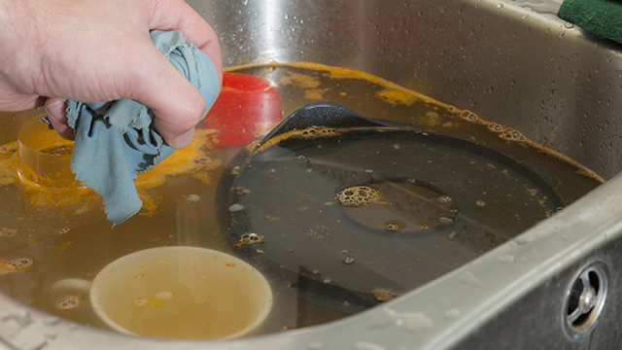
The When
Notes:
And this lovely 3-compartment sink? Sink sanitizer solutions should be changed every four hours - or as needed if the water becomes soiled.
Facilities must monitor, test, and change sanitizer solutions to ensure the proper concentration at all times, per manufacturer’s recommendation.

Slide 23
The How
Notes:
Therefore:
First ask to see the test strips and have a manager or employee test the sanitizing solution. Ensure that the employee starts with the right sanitizer and follows directions. Asking them to provide the strips will show you if they keep them readily available… an employee scrambling to find them is a bad sign!
Secondly, watching them do the test will show you if they know how.

Slide 24
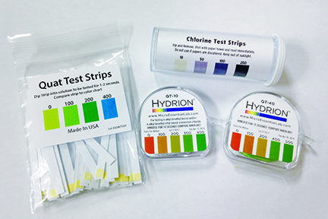
The How
Notes:
Ensure the facility has the correct kit for their sanitizer solution(s). Test kits are not interchangeable. Also, kits can expire - so be sure to check the date on the dispenser as well.
Pass around sample test kits and ask participants to describe how they would ensure the kit is being used. Has it been opened at all? Stored in locked drawer? Did the manager / employee know how to use it?
Let’s assume that you ask to see a facility’s test kits and you receive a kit that resembles one of those being passed around the room.
What can you discern by looking at these kits?
Example rolls on next 4 slides
In this slide: chlorine, QT-10, QT-40, QAC

Slide 25
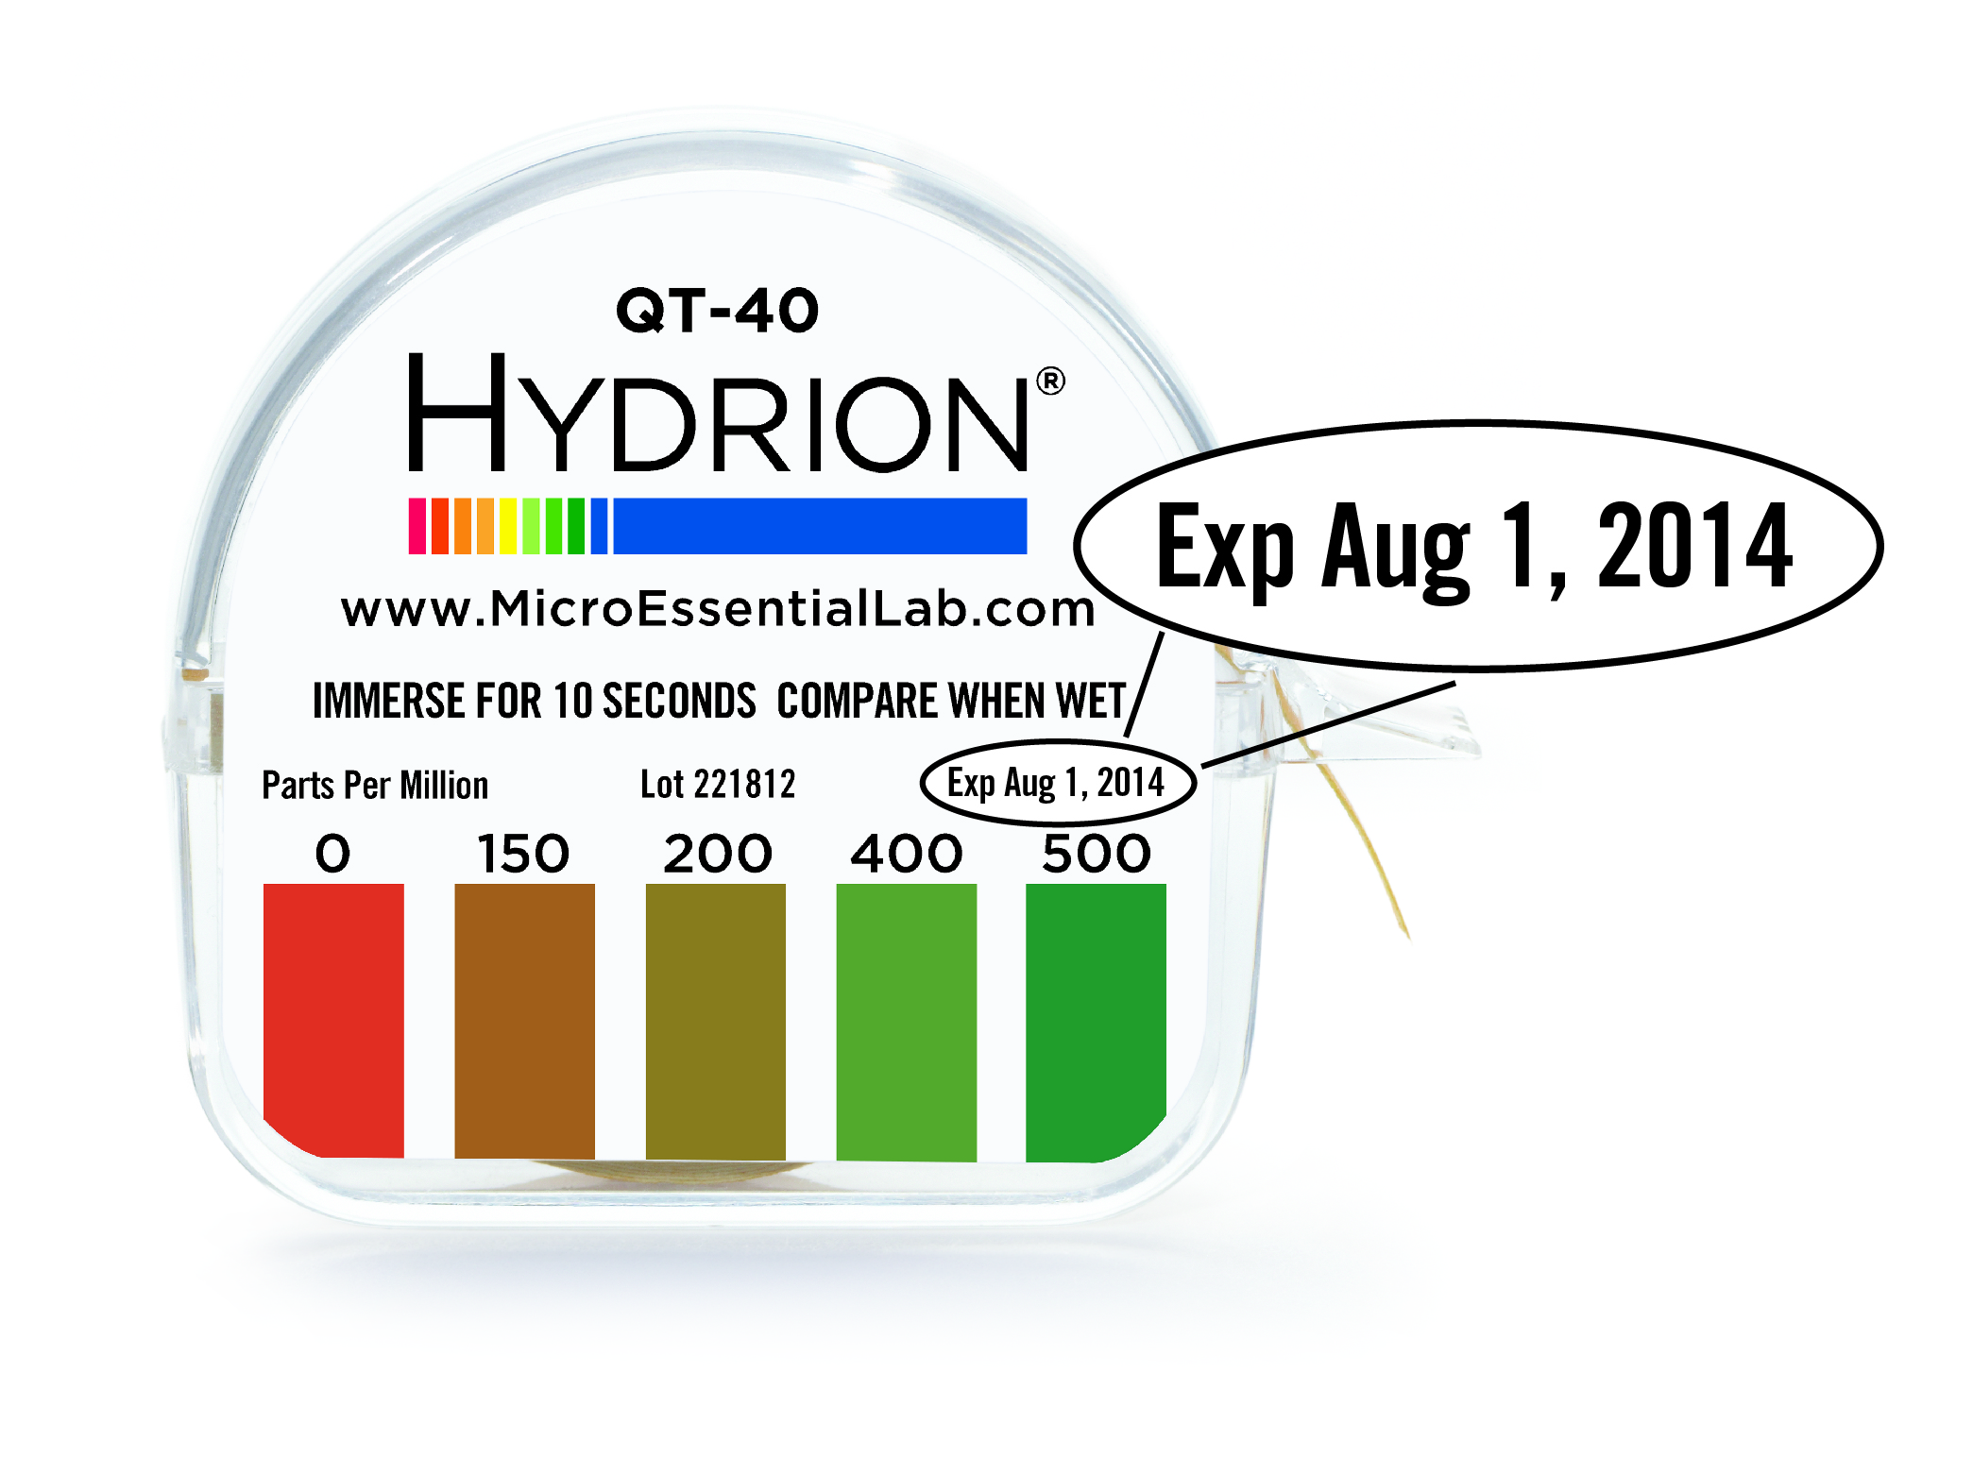
The How
Notes:
Make sure participants catch the following examples of “bad” test kits shown on the next 4 slides.
1. This is an example of an expired kit. Expired kits should be thrown away.

Slide 26
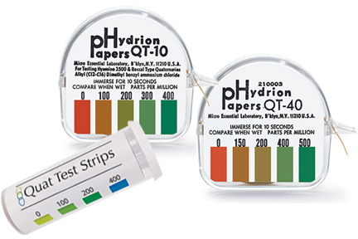
The How
Notes:
2. Kits without dates were made long ago, before expiration dates were printed. They expired years ago.

Slide 27
The How
Notes:
3. Here is a new kit - still wrapped in foil. If this is presented as the active kit, they likely aren’t testing.
At 180 inches, there is little likelihood that they are actually just starting a new roll.

Slide 28
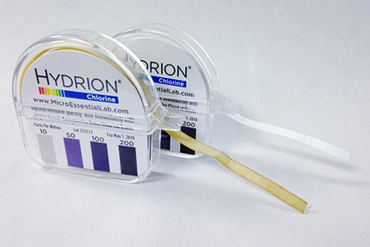
The How
Notes:
4. What about these?
What is wrong with the roll in front? Damaged or contaminated kit
What can cause this? Oxidation by exposure to air, humidity, or chemical fumes
The first kit has likely been exposed to the air, humidity or chlorine gas for too long. If you see a test paper roll that resembles the roll in front, you can be pretty safe in assuming it is NOT being used in the facility.
Can anything be done with that roll? Dispose of the roll. May tear-off 2 inches after end of oxidation, if possible, to still use.

Slide 29
The How
Follow instructions on kit:
Water temperature for TESTING
Foam and swishing
Time
Blotting
Color chart
Reading the results
Notes:
Finally we’re ready to test the solution(s).
Depending on the sanitizer used, we’ll need to pay attention to:
Water temperature
Foam and swishing
Time
Blotting
Color chart
Reading the results

Slide 30
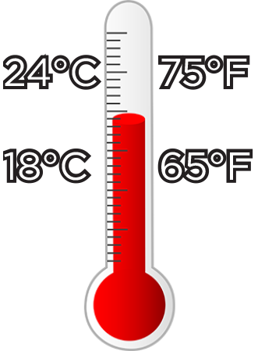
The How - Quats
Notes:
Let’s start with quats.
First review the directions:
Does the sanitizer require a specific water temperature?
The general recommendation for quats is to be tested at room temperature, 65°F-75°F (18°C-24°C).
Use a pre-cut test strip, or tear off approximately 2 inches of the roll of test paper.

Slide 31
No testing bubbles!
No swishing the strip around!
The How - Quats
Notes:
Quats will often foam when filling a sink or bucket with solution. Avoid testing the foam by either testing a clear area or letting the foam dissipate prior to testing.
The foam has a higher concentration of sanitizer and therefore gives incorrect results.
NO swishing either! Again, it will force chemical into the strip and give a false high reading or give a modeled affect to variable uptake of the sanitizer.

Slide 32
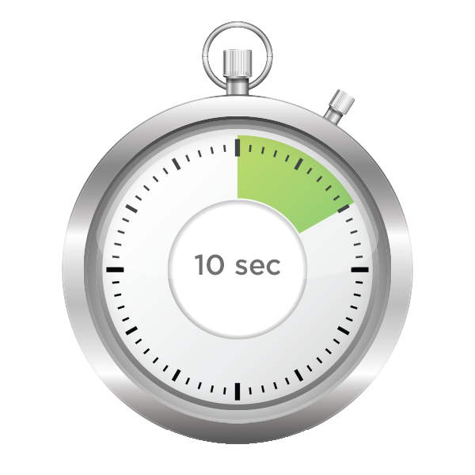
The How - Quats
Notes:
Make sure the foam is gone, and the test strip goes directly in to the water. Dip the strip in to the sanitizer water.
Leave the strip in the solution for the correct amount of time based on the type of sanitizer being used (usually 10 seconds). Do not swirl or move the strip – hold it still.

Slide 33
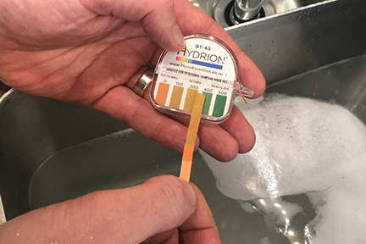
The How - Quats
Notes:
Remove the test strip and immediately compare it to the color chart.
The color chart is conveniently found on the test strip dispenser. To determine the concentration of sanitizer, match the color of the strip after dipping to the closest color on the chart provided. Each color represents a different sanitizer concentration in parts per million, or ppm.
Show on the slide:
If a quat reading is between 150ppm and 400ppm for 4-chain quats, then the concentration is fine.
2-chain quats generally 200ppm “not to exceed” 400ppm. Read the label.

Slide 34
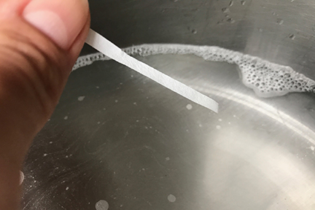
The How - Chlorine
Notes:
Testing chlorine solution is only slightly different.
First? Review the directions.
Does the sanitizer require a specific water temperature?
As we saw in the table earlier, the minimum temperatures for chlorine solutions can vary based on the pH of the solution.
Room temperature, 65°F-75°F (18°C-24°C), is still a safe bet, as are solutions with cooler temperatures. The warmer the water in a chlorine solution, the lower the concentration of available chlorine is needed to show a “sufficient” amount of sanitizer. So, if the water is not too hot, the test will work correctly.

Slide 35
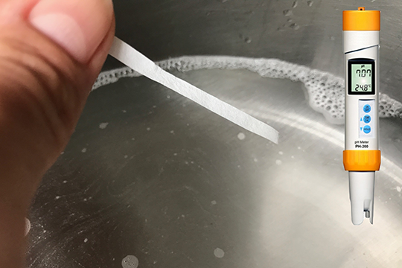
The How - Chlorine
pH
Notes:
The table provided chlorine concentrations based on the solution having maximum pH values of 8 or 10. The water supply should ensure the pH never go above those levels, but pH meters are available for intermittent testing.
As with the quats, use a pre-cut test strip, or tear off approximately 2 inches of the roll of test paper.
A chlorine test strip can be dipped and promptly removed – without waiting the 10 seconds as needed for the quats.

Slide 36
The How - Chlorine
Notes:
Make sure to read the directions - some chlorine test kits require you to “blot” the strip on a paper towel prior to comparing to the color chart.

Slide 37
The How - Chlorine
Notes:
Chlorine bleach should be between 50 and 100ppm.
The chemical manufacturer generally determines the concentration for effective sanitization; read the label.

Slide 38
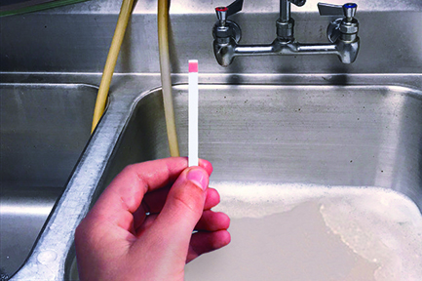
The How
Notes:
When testing either a quat or chlorine solution, if the concentration is too low or too high, add sanitizer or dilute with water as needed in order to achieve the required concentration.
Be sure to retest.
Remember to test following the cleaning and sanitizing of wares also to determine if the solution is still at the proper sanitization level. You need to ensure that the last items sanitized were done at the correct concentration too - not just the first ones.

Slide 39
We thank you for protecting public health!
Rob Lynch
Director of Sales and Technical Services
Micro Essential Laboratory, Inc. 4224 Avenue H • Brooklyn, NY 11210
rob@microessentiallab.com
718-928-2913
Notes:
From all of us at Micro Essential Laboratory, thank you for joining us today and thank you for protecting public health through proper sanitizing!
We hoped you learned something that you are able to take back with you and pass on to those front-line food safety people in the field. We want to help you to help others keep consumers safe.
I’ll be around for a few minutes if you have any other questions.

