Slide 1
Body Art Regulation: Public Health Considerations and Practical Application
Paul Shoemaker, MPH, MBA
Director, Environmental & Occupational Health Division
Boston Public Health Commission
October 21, 2021

Slide 2
Disclaimers
This presentation describes the history, content, and implementation of regulations governing the body art industry in Boston. Other municipalities may have regulations that differ from those described here. Practitioners and business owners are advised to consult with their local regulatory agency for local specifics prior to taking any significant business actions relative to regulations.
Any opinions or speculation beyond the scope of current regulations and regulatory implementation are those of Paul Shoemaker personally and not the views, opinions, or policy of the Boston Public Health Commission.
Paul Shoemaker has no financial or personal relationship with any businesses mentioned in this presentation or governed by the Boston Body Art Regulation.

Slide 3
Where We’re Going
Public Health & Safety Concerns of Body Art
History of the Boston Body Art Regulations
Requirements of the Regulations
Implementation and Enforcement
Challenges and Lessons Learned

Slide 4
Learning Objectives participants will be able to:
Explain
Explain the primary public health concerns of the practice of body art and basis for regulation
Describe
Describe the key components of the Boston Body Art Regulations
Identify
Identify the aspects of effectively inspecting a body art establishment and artist workstation

Slide 5
Boston Public Health Commission
Board of Health for the City of Boston
Mission: To protect, preserve, and promote the health and well being of Boston’s residents, particularly the most vulnerable

Slide 6
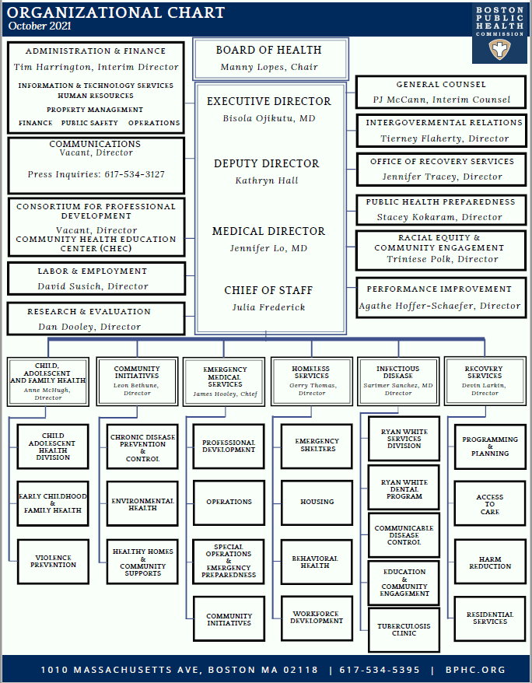
Environmental & Occupational Health Division
Mission: To respond to the full range of environmental and occupational public health issues in residences, public buildings, businesses, industry, and the environment, which pose a health threat to the citizens of Boston, particularly those most vulnerable.

Slide 7
Values
Environmental Justice: The fair treatment and meaningful involvement of all people. Everyone should enjoy the same degree of protection from environmental health hazards and equal access to the decision-making process to have a healthy environment.
Environmental Justice
Health Equity
Place-Based Health
Place-Based Health: The physical environment can often have a stronger impact on health outcomes than individual behavior. Your ZIP code often matters more than your genetic code in determining your health.
Health Equity: The absence of avoidable, unfair, and unjust differences in health outcomes among different groups of people. Everyone has a fair and just opportunity to lead a healthy life without social, economic, and environmental obstacles they face.

Slide 8
What We Do
6 Programs
Services
Lead Poising Prevention Program
Inspection, environmental follow-up, medical follow-up, and case management for children with elevated blood lead levels and outreach efforts to prevent lead exposure.
(from nearly 5,000 poisoned children in 1994 to 81 in 2015)
Investigation, enforcement, and correction of environmental hazard complaints in homes, businesses, public buildings, and outdoor spaces throughout the city.
(714 inspections of 532 complaints in 2019)
Environmental Hazards Program
Permitting Program
Permit and inspect 9 industries: asbestos removal, solid waste/recycling, nail salons, tanning salons, body art, medical marijuana, indoor ice rinks, private wells, funeral directors
(2,248 permits issued in 2019)
Burial Permits Program
Part of the vital records process, issue permits for transportation/burial/cremation of remains of individuals who die in Boston or are transported to Boston for final disposition.
(9,065 permits in 2020)
Biosafety Program
Oversight and regulation of biological research laboratories in Boston working with recombinant genetic material or biosafety level 3 or biosafety level 4 organisms.
(31 permitted laboratories in 2021)
Occupational Health & Education
Education, outreach, and technical assistance to small businesses on pollution prevention and worker protection.
(1,504 outreach visits in 2019)
7th overarching focus area – Climate Change mitigation and adaptation

Slide 9
What is Body Art
Artistic or personal expression using the human body as medium. Common practices include:
Tattoos
Piercings
Microblading/permanent cosmetics
Dermal implants
Scarification
Branding

Slide 10
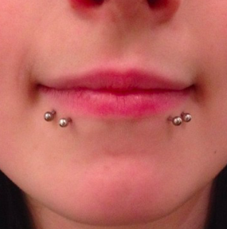
Public Health and Safety Concerns
Infection of client or artist due to non-sterile conditions
Physical injury from unsafe equipment or practices
Improper/unsafe disposal of biohazard waste

Slide 11
History of the Boston Body Art Regulations
1962
Massachusetts bans tattooing except by a physician
2000
State ban ruled unconstitutional by the MA Superior Court
Jan. 2001
MA DPH issues model body art regulations
23 May 2001
BPHC promulgates Boston Body Art Regulations
19 Sep. 2017
BPHC revises regulatory guidelines to include permanent cosmetics
Today
16 active body art establishments and 87 licensed artists

Slide 12
Requirements of the Regulations
Standard requirements for physical establishments including annual permit and inspection
Experience/training requirements for artist licenses and annual license renewal
Requirements for safe work practices & equipment
Restrictions on clients (age, impairment, health)

Slide 13
Establishment Requirements
Annual permit required except:
licensed physician’s practice
businesses that do only ear piercing
Zoning compliance and Use and Occupancy permit
Floorplan separates practice area from public and other businesses
Emergency plan
Medical waste disposal contract
Clean room and sterilization equipment
Restrooms and hand washing sinks
Workstations have sufficient size, lighting, and separation
Hand washing sinks

Slide 14
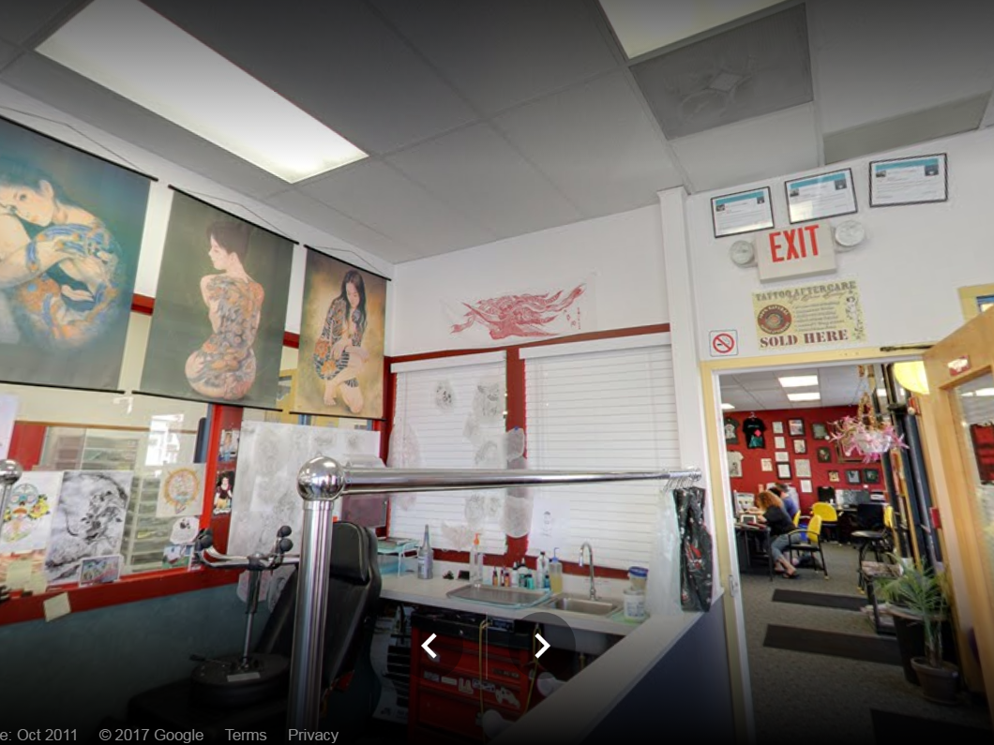

Slide 15
Artist Requirements
Documentation of prior experience in the body art type on initial application:
Previous year’s Boston license
One or more years of licensure in another jurisdiction
Documentation of a successfully completed apprenticeship
Completion of approved training course and apprenticeship (permanent cosmetics only)
Current First Aid/CPR training certification
Current Blood Borne Pathogen training certification
Completion of an Anatomy and Physiology course (piercer only on initial application)
On-site inspection of work practices

Slide 16
Work Practice Requirements
Client consent/release statement and record keeping
Screening of client for exclusion items (age, health factors, intoxication)
Sanitation of workstation
Covering of work surfaces with barrier film
Sanitation of tools – wash/ultrasonic cleaner and autoclave
Use of single-use tools
Single-use ink ‘caps’, bagging machine/cord (for tattooing)
Proper hand-washing and glove use
After-care instructions
Proper cleanup and disposal

Slide 17
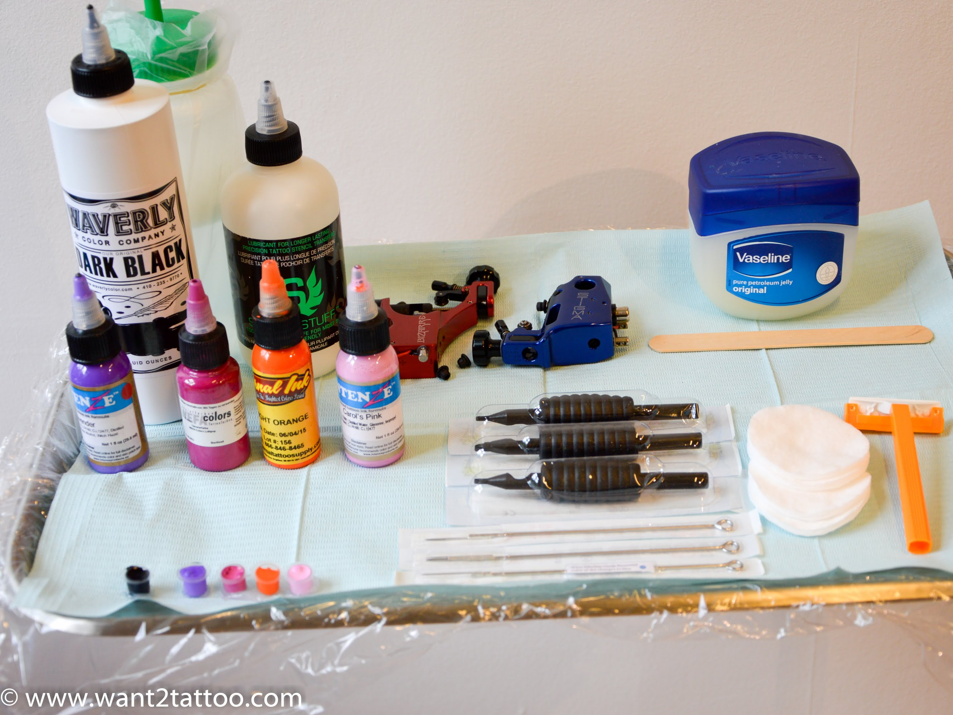

Slide 18
Client Restrictions
Under 18 – No tattooing, piercing genitalia, branding, or scarification
Under 14 – No piercing at all
14-17 y/o – Piercing (except genitals) if a parent or legal guardian is present and signs a consent
No body art if client impaired by alcohol or other drugs
No body art on any part of a client showing a visible rash, lesion, or sign of infection
Some medical conditions may prevent receiving body art or require special considerations

Slide 19
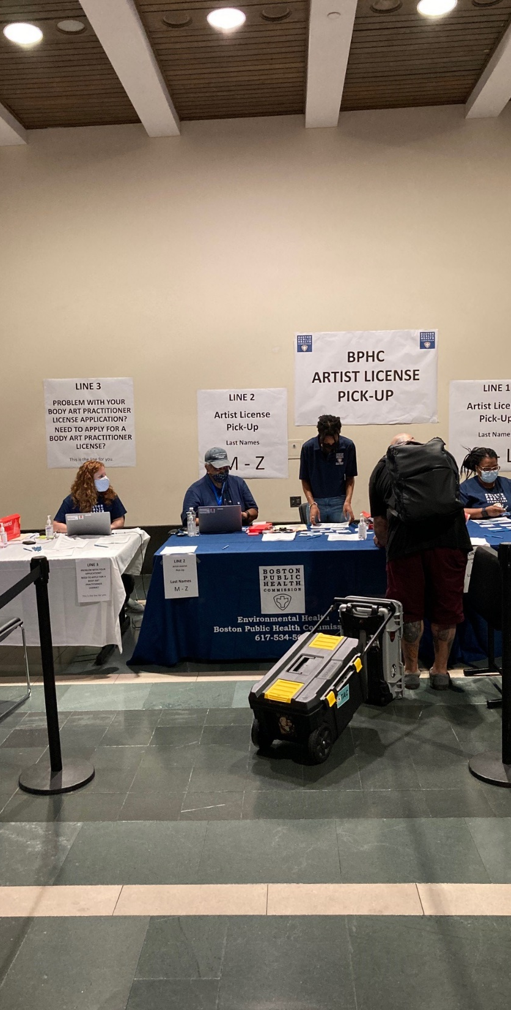
Implementation & Enforcement
Annual permitting of businesses and licensing of artists
Routine inspections
Initial and annual inspections of permitted businesses
Initial assessment/inspection of new artists
Complaint-based inspections of permitted businesses and licensed artists
Investigation of unlicensed artists/shops
Licensing guest/temporary artists and permitting temporary locations

Slide 20
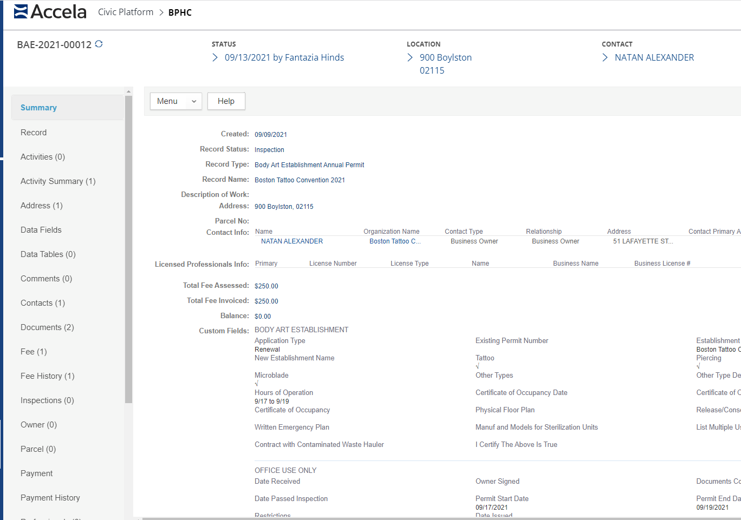

Slide 21
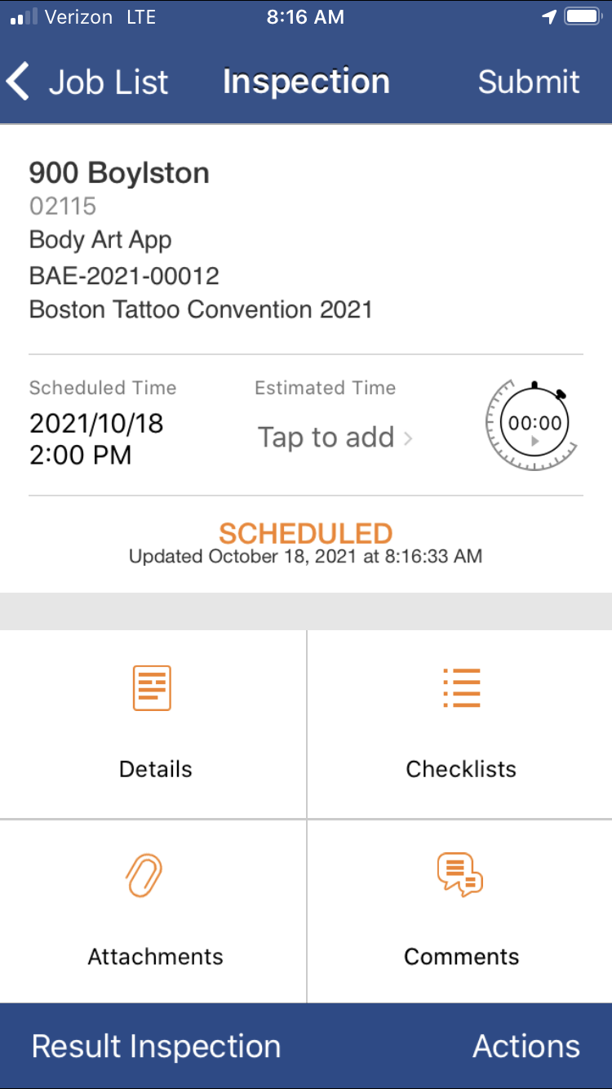
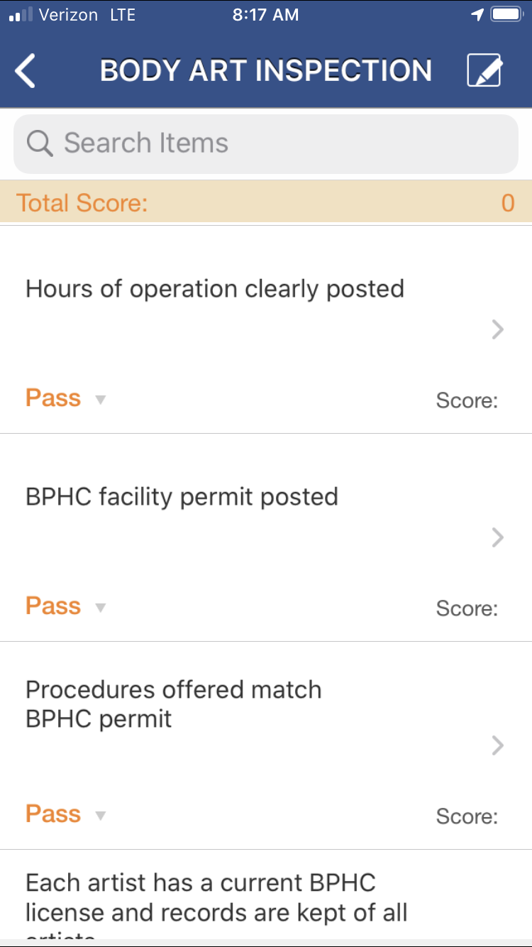

Slide 22
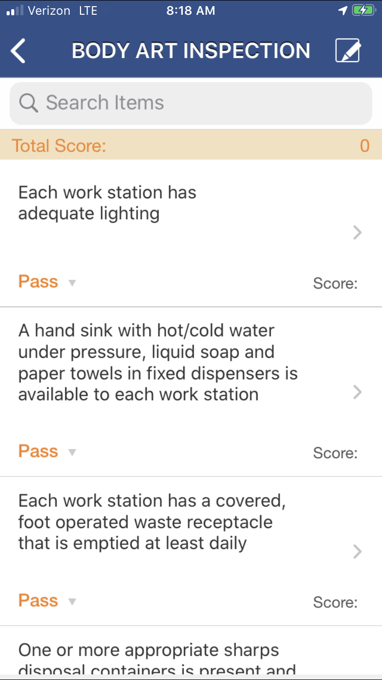
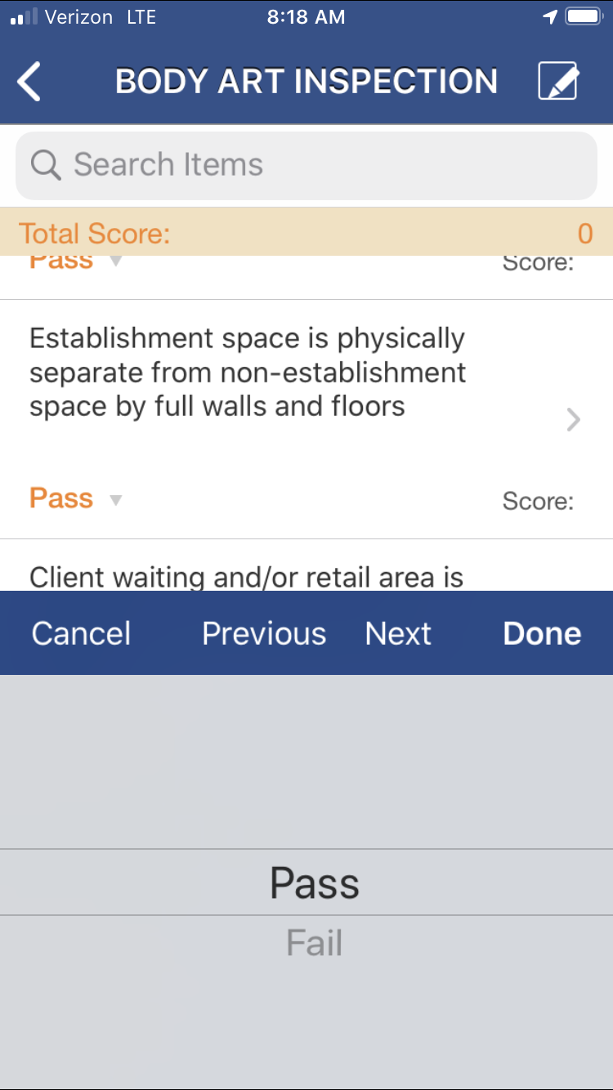

Slide 23
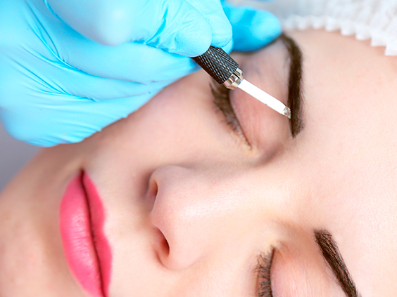
Challenges and Lessons Learned: Microblading
Also called micropigmentation, permanent cosmetics, permanent makeup, cosmetic tattooing and similar
Uses the principles of tattooing to replicate the appearance of applied cosmetics, such as enhancing eyebrows, lip liner, eyeliner, etc.
New community of practitioners and businesses
Until 2017, prohibited in salons licensed by the MA Board of Registration of Cosmetology and Barbering (BOC). Now allowed with certain conditions.
Cosmetologists unable to meet the required documentation of prior experience in tattoo parlor and beauty salons do not have “body art” as part of their Use and Occupancy
Tattoo industry trains practitioners using apprenticeships, while cosmetology industry focuses on formal classroom education
Training classes for permanent cosmetics being offered across the country are of varying rigor

Slide 24
Challenges and Lessons Learned: Unpermitted Practitioners
Body art is a very mobile profession with artists traveling from state to state and regulations can vary greatly from state to stake or between municipalities within the state.
Businesses can open unaware of the requirement to be permitted and the requirements of that permit, leading to enforcement action.
Difficulty of catching the “scratchers” and enforcing against them – anyone can buy a “tattoo kit” for under $50 on Amazon.
Artists working out of their homes and doing house parties are difficult to enforce against and increased greatly during the COVID-19 pandemic.

Slide 25
Questions? Discussion?
Paul Shoemaker
617-534-5965
pshoemaker@bphc.org
www.bphc.org

