Slide 1
Title 5 Plan Review: A Hands On Approach
Andrew Osei and Brian Dudley, MassDEP
October 21, 2021
2021 MHOA Educational conference, FALMOUTH, MA

Slide 2
DISCLAIMERS
Any proprietary technology mentioned in this presentation is used purely as an example and its inclusion does not constitute a comment on or endorsement of the technology by the presenter or MassDEP.
This presentation relates solely to 310 CMR 15.000, Title 5 of the State Environmental Code. Many municipalities have regulations that are more restrictive than Title 5.

Slide 3
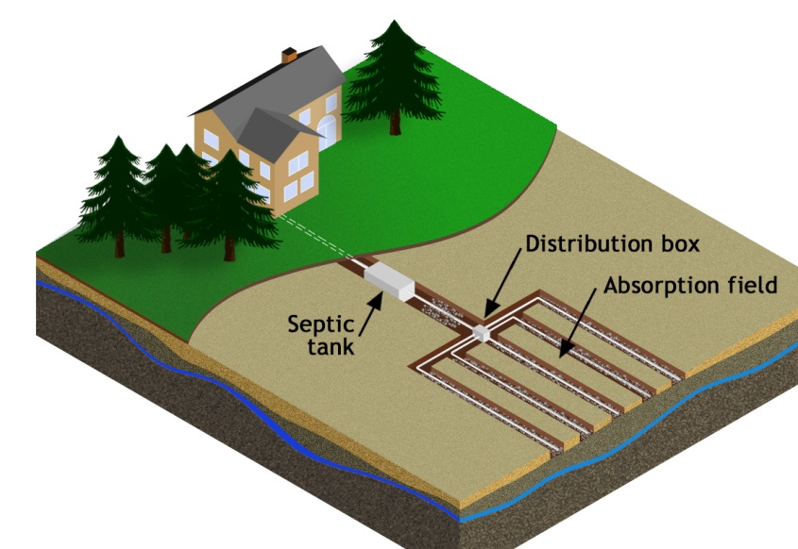
Objectives
Septic system plan basics
Non-conventional
systems
Checklists
Hands-on exercise
Deficiency and approval
letters
Wrap-up

Slide 4
Septic System Plan Basics

Slide 5
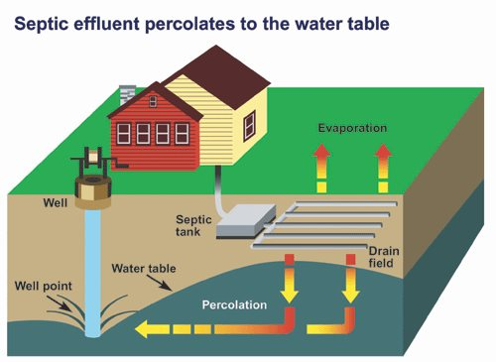
Septic System Components
Building sewer
Grease trap*
Septic tank
Alternative technology*
Pump chamber (pre/post)*
Distribution box*
Soil absorption system
Vents and inspection port

Slide 6
Design Plan Components
Plan view of the system showing entire lot and all components
Profile of the system
Details of the components
Soil evaluation and percolation testing information
SE and certification statement
BOH witness

Slide 7
Soil Information
Within 60 days after soil testing,
SE of record must certify soil results to BOH
SE of record must submit soil results to BOH
Plans should include:
All deep hole locations and logs (incl. elev.)
Perc test locations and logs (incl. elev.)
Soil evaluator of record and BOH witness as well as other important information

Slide 8
Plan and Profile
Site plan
Property lines/ROWs
Buildings/structures and Paved surfaces
Profile
To scale
Elevations
Designer Stamp: PE or RS (PLS stamp?)

Slide 9
System Components 1:
Building Sewer
Septic Tank
Material
Slope
Access (change in direction)
Size/Compartment(s)
Inverts
Material
Tees/baffles/filter
Inlet/outlet drop
Accessibility

Slide 10
System Components 2:
Pump Chamber
Distribution Box
To septic tank
Pump type
Sizing/compartments
To d-box or SAS
Material
Storage
Alarms
Dual pumps?
Material
Sump size
Level outlets

Slide 11
System Components 3 – SASs:
Type – bed/field, trench, gallery/pit/chamber
LTAR
Size
Calculations shown – Mounding calculations?
Reductions taken?
Adequate depth to groundwater
Venting
Inspection port

Slide 12
Non-conventional Systems

Slide 13
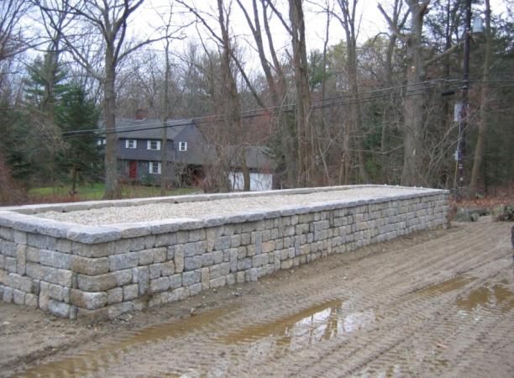
Non-conventional System Designs:
Tight tank
Shared system (cluster or not)
Nitrogen aggregation approval
Alternative technology
Secondary treatment unit (STU)
Patented sand filter
Drip dispersal system
Alternative SAS

Slide 14
Alternative Technology Considerations:
Type of MassDEP issued approval
Model of the technology
Compliance with terms and conditions of approvals
Best feasible alternative identification and siting
Owner acknowledgement
Deed notice

Slide 15
Checklists

Slide 16
WHY?
WHO?
WHAT?
HOW?

Slide 17
Who Benefits from Checklists?
Health Department staff
Board of Health members
Consultants to the Dept/BOH
Designers
Installers
Property owners/public

Slide 18
Why Use a Checklist?
Multiple programs
Multiple reviewers
Septic
Food
Housing
Pools
Public health/nursing
Emergency preparedness
BOH staff
Town/City engineering staff
Consultants
Others
ConCom
Building Dept.
Etc.

Slide 19
Some things to Include in a Checklist(s):
Regulations
Title 5
Local bylaw
Design flow
Soil testing
Component standards
SAS design
Tight tanks
Greywater systems
Alternative technologies
Standard conditions
Nitrogen aggregation approvals
Shared systems
Timelines for review

Slide 20
How Do You Create a Checklist?
Make your own from scratch
310 CMR 15.220, especially 15.220(4)
Barnstable County Health Department
MassDEP
Recommended:
Start with MassDEP’s revised checklist (Sep 2019) and remember to include any local bylaws/regulations

Slide 21
Deficiency and Approval Letters

Slide 22
Standard Letters
deficiency
approval
Deficiency date
Meeting or hearing date
Plan name, date & designer
Deficiencies
Listed & detailed
Regulatory, policy, guidance & approval citations
Approval date
Meeting or hearing date
Plan name, date & designer
Special conditions
Coordination with BOH agent
Flagging of components
Watertightness testing, etc.

Slide 23
Wrap-Up

Slide 24
Common Barriers to Compliant Systems
Poor soils;
Ledge;
Small lot;
Wetlands;
On-site well; or
Any combination/permutation of the above.

Slide 25
Hands On Exercise

Slide 26
Acknowledgements and Thanks
Demo Plan preparation
Kirk FitzPatrick, E.I.T.
Civil Solutions
Westford
Kevin Richie, P.E.
Civil Solutions
Westford

Slide 27
There are only two rules for upgrades…..
Rule # 1
Rule # 2
Full compliance is always the goal!
[310 CMR 15.404(1)]
Don’t forget Rule #1!

Slide 28
?
?
Questions?
?
?

Slide 29
MassDEP REGIONAL CONTACTS
CERO
David Boyer
david.boyer@mass.gov
508-767-2823
NERO
Wastewater Info Line
978-694-3215
Claire Golden
claire.golden@mass.gov
978-694-3244
SERO
Brian Dudley (Cape) Brett Rowe (SE MA)
brian.dudley@mass.gov brett.rowe@mass.gov
508-946-2814 508-946-2754
WERO
John Bourcier Dan Kurpaska
john.bourcier@mass.gov daniel.kurpaska@mass.gov
413-755-2112 413-755-2274
Matt Sokop
matthew.sokop@mass.gov
413-755-2218

