Slide 1
Food Inspection Report Writing 101
By Stephanie Holinko, CP-FS
Sergio Espinoza, President, We Serve Safely

Slide 2
Presentation Goals
Goal #1: Inspectors will have a better understanding of their inspection documentation responsibilities in accordance with the MA Food Code.
Goal #2: Inspectors will become familiar with the 2013 Federal Food Code Annex 5 to improve their inspections.
Goal #3: Through better documentation, inspectors will see compliance improvements in food facilities.
Goal #4: Inspectors will complete detailed inspection reports and descriptively report inspectional findings.

Slide 3
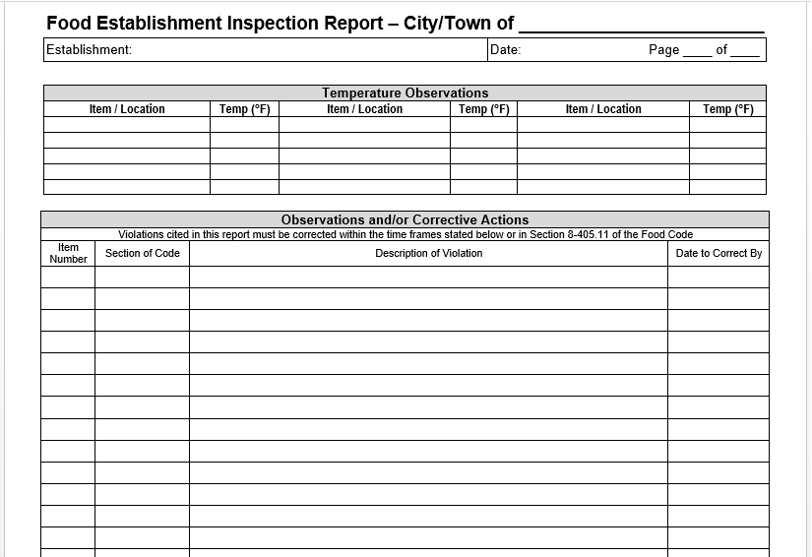
This is the section of the food inspection report we are focusing on today:

Slide 4
What inspired us to this presentation today?
Reviewing a lot of food inspection reports in many municipalities throughout the state with very little information.
Food inspection reports with no narrative. Only cover sheets completed.
Inspection reports failing to specify a plan for correction.
Violations reported with very little information. (i.e. not specifying the location of the violation, equipment information, etc.)
Plan for correction is commonly missing on inspection reports. Inspectors are not specifying the expectations for correction.
SE

Slide 5
PRESENTATION INSPIRATION: Example of a recent food inspection report for a full service restaurant with no narrative page. This was the only information reported. (VERY COMMON INSPECTION REPORTING IN MASSACHUSETTS)

Slide 6
More presentation inspiration: Reinspection report narrative page.
-Specify date of previous inspection report.
-Specify how the previous violation was corrected on the report.

Slide 7
More presentation inspiration: This report is much better but still not compliant with reporting. This report is still missing required documentation.
Observed violations not specified.

Slide 8
Why is detailed inspection report findings important?
INSPECTIONAL FINDINGS ARE REQUIRED PER THE FOOD CODE
Specific inspectional report findings are required per 105 CMR 590.000 State sanitary code chapter X: Minimum sanitation standards for food establishments
8-403 Report of Findings
8-404 Imminent Health Hazard
Remember: There are many sections of the food code that apply to the responsibilities of the REGULATORY AUTHORITY. If inspectors are not complying with the REGULATORY AUTHORITY sections of the food code, how can we expect a business to comply?

Slide 9
Why is detailed inspection report findings important (Continued)?
To help the business better achieve compliance and understanding of their responsibilities.
If it’s not written on the report, it wasn’t said.
To help other future inspectors know what was observed on previous inspections.
To protect your reputation as an inspector and the Departments reputation if something goes wrong.
The general public has the right to know what was observed during a food inspection. REMEMBER: Every one of us are stakeholders in retail food safety.
Detailed reports will provide your Board of Health with a better understanding of the severity of issues in the case you need to bring the business in front of the Board of Health.

Slide 10
What are you required, per the food code, to document on the narrative section of the food inspection report?
8-403.10 (B)(2): “Specific factual observations of violative conditions or other deviations from 105 CMR 590.00, that require correction by the permit holder.”
8-403.10 (B)(1)(d): “Time Frame for Correction”
Code section (technically not required in the code but good practice).
8-404.20: Corrective action demonstrated by the establishment must be documented.
The violation must still be documented even if corrective action happens immediately (COS).
SE

Slide 11
What is Annex 5 “Conducting Risk Based Inspections” of the 2013 Food Code?
Found right in the 2013 Federal Model Food Code (page 587 -620.
“Annex 5 of the Food Code outlines the basis for conducting successful risk-based inspections and is provided to assist industry in achieving active managerial control of foodborne illness risk factors as outlined in the draft Recommended National Retail Food Regulatory Program Standards and the Regulator’s Manual.”
https://www.fda.gov/media/87140/download

Slide 12
Why should you become familiar with Annex 5 and how does it relate to this presentation?
Annex 5 specifies details that should be documented on the inspection report including but not limited to:
On site corrections made during the inspection.
Evidence of violations observed during the inspection (photos in addition to the description on inspection reports are helpful).
The establishments compliance place/plan for correction.
Compliance plans should be discussed during the closing conference with the Person in Charge and then documented on the inspection report.
Solutions/alternatives for compliance to prevent the reoccurrence of violations.
Keep an open line of communication.
Documentation of inspectional findings including temperatures and sanitizer concentrations.
SE

Slide 13
Overview – what you need to document on the report
1) The code section.
2) The specifics about the violation you observed (i.e. location, equipment, food item, etc.).
3) Time frame for correction.
4) Corrective Action.
5) Plans for correction.
6) Expectations for correction.
Specify if the violation was corrected on site and how it was corrected. Specify if it was a repeat violation.
Document the violation in way to prevent the violation from reoccurring.

Slide 14
Consideraciones / recomendaciones sobre la barrera del idioma
La seguridad alimentaria es demasiado importante para asumir que se entiende, se debe entender.
"Aunque los inmigrantes representan solo el 13.5 por ciento de la población de los EE. UU., Un informe de 2017 del Consejo de Asuntos Globales de Chicago estima que el 37 por ciento de los propietarios de pequeños restaurantes son inmigrantes, mientras que el 22 por ciento de los trabajadores de servicios de alimentos son nacidos en el extranjero".
Abogando por un servicio de traducción.
Ofrecer reunirse con la empresa en la oficina con un amigo o familiar que pueda traducir.
Lenguaje simple (en lugar de alimentos TCS, especifique los nombres específicos de los alimentos).
Utilizar el traductor de Google para documentos electrónicos.

Slide 15
Language barrier considerations/recommendations
Food safety is too important to assume its understood, it must be understood.
“Although immigrants make up just 13.5 percent of the U.S. population, a 2017 report from the Chicago Council on Global Affairs estimates that 37 percent of small restaurant owners are immigrants, while 22 percent of foodservice workers are foreign-born.”
Advocating for a translation service.
Offering to meet with the business in the office with a friend or family member who can translate.
Simple language (instead of TCS foods, specify the specific food names).
Utilizing google translate for electronic documents.

Slide 16
Example of how to document a violation
3-302.11 Uncovered foods
Observed frozen french fries, frozen chicken patties and frozen fish stored uncovered in the single door GE freezer. Frozen food must be stored protected through means such as covered containers or wrappings. The Person in Charge has agreed to purchase food grade containers with tight fitting lids. The Person in Charge will be re-training food employees to keep foods completely covered while in storage. The Person in Charge covered the foods with plastic wrap during inspection.

Slide 17
The Breakdown
The code section: 3-302.11
The observed violation: Observed frozen french fries, frozen chicken patties and frozen fish stored uncovered in the single door GE freezer.
The expectation for compliance: Frozen food must be stored protected through means such as covered containers or wrappings.
The corrective action for sustainable and permanent change: The Person in Charge has agreed to purchase food grade containers with tight fitting lids. The Person in Charge will be retraining food employees to keep foods completely covered while in storage. The Person in Charge covered the foods with plastic wrap during inspection.

Slide 18
Another example of how to document a violation
3-305.11
Packages of pork observed being stored directly on the floor in the walk in cooler. Food must be stored at least 6 inches off of the floor on the approved shelving. The owner has agreed to purchase an aluminum dunnage rack for additional shelving space in the walk in cooler. Please train staff to not store food on the floor and only on the approved shelving.

Slide 19
Practice citing violation in groups of 2-3
-Violation 3-501.16
-Cooked pasta
-61.9°F stored in ambient temperature on the cooks line.
-Your group determines the correction action.

Slide 20
How the violation was cited and the outcome
3-501.16
Cooked pasta observed with an internal food temperature of 61.9°F stored on the cooks line in ambient temperature. Cooked pasta must be maintained in cold holding at 41°F or below. The cook was unsure how long the pasta was out in ambient temperature and therefor decided to dispose of the pasta. The owner stated he will purchase a cold holding unit for the pasta. Please submit the manufacturer’s specifications for the cold holding unit for inspector approval prior to purchasing.

Slide 21
Practice citing violation in groups of 2-3
3-305.11; 3-305.14
Pork prepared on floor next to 3 bay sink

Slide 22
How the violation was cited and the outcome
3-305.11; 3-305.14
Pork in a large bowl was observed being mixed directly on the floor by a food employee. The inspector advised the Person in Charge that food could not be prepared directly on the floor and must be prepared in an approved food preparation area such as a food prep table or food preparation sink. The PIC directed the employee to finish preparing the pork on a food preparation table. Please train all food employees on where food is approved to be prepared.

Slide 23
Questions
Bodega cat
Contact information:
weservesafely.com
Stephanie Holinko
860-690-9569 (cell)
s.holinko@weservesafely.com
Sergio Espinoza
860-490-5888 (cell)
s.Espinoza@weservesafely.com

