Slide 1
MassDEP 2021
Once again, thanks to Our Health Officers!
Issues today:
  Climate Priorities
  Solid Waste Master Plan
  PFAS
  Sewer Overflow Notification Law
Notes:
What are PFAS? Class of chemicals, family of thousands.
Resistant to heat, highly repellant. Highly durable – attractive for manufacturing but don’t break down in the environment and levels accumulate in people.
Some PFAS bioaccumulate, and they don’t degrade.
Dissolve in water

Slide 2
MassDEP 2021
MassDEP Work in 2021/COVID
MassDEP: we are in business! Website: mass.gov\dep
Transition to Hybrid workplace
Continued Coordination with Water Suppliers, Wastewater Operators and Waste and Recycling Sector
Notes:
What are PFAS? Class of chemicals, family of thousands.
Resistant to heat, highly repellant. Highly durable – attractive for manufacturing but don’t break down in the environment and levels accumulate in people.
Some PFAS bioaccumulate, and they don’t degrade.
Dissolve in water

Slide 3
MassDEP 2021
Climate Change
  Transportation
  Resiliency & Wetlands
Notes:
What are PFAS? Class of chemicals, family of thousands.
Resistant to heat, highly repellant. Highly durable – attractive for manufacturing but don’t break down in the environment and levels accumulate in people.
Some PFAS bioaccumulate, and they don’t degrade.
Dissolve in water

Slide 4
2020-2030 Solid Waste Master Plan
The 2020-2030 Solid Waste Master Plan:
  Issued 10/18
  Establishes the Commonwealth’s policy framework for reducing and managing solid waste.
  Proposes a broad vision and strategies for how the Commonwealth will manage our waste over the next decade and beyond.
  Is prepared in accordance with the requirements of Massachusetts General Law Chapter 16, Section 21.

Slide 5
SWMP Plan Highlights
Sets aggressive disposal reduction goals for 2030 and 2050 supported by new strategies
  2030 Disposal Reduction Goal of 1.7 million tons/year
  2050 Disposal Reduction Goal of 5.1 million tons/year
  Aligns efforts with Commonwealth Climate Goals by efforts to address emissions
Expands successful Food Waste Reduction Program
  Set more aggressive goals for further reduction of food waste by 500,000 tons annually
Establishes New Bans for Mattresses and Textiles
  Implement new bans on mattresses and textiles,
  Bans supported by established and enhanced assistance, outreach and market development programs
  Increase inspections and enforcement of current bans

Slide 6
SWMP Plan Highlights
Improves Programs and establishes ongoing engagement with Environmental Justice communities
  Updating grant program criteria to prioritize and increase grant awards to EJ communities
  Promote use of hybrid/electric trash and recycling trucks in EJ Communities
  Ongoing engagement to address community issues
Dynamic and flexible plan, with built in opportunities to refine and update
  Continue to develop specific action plans for food waste, construction materials, reduction & reuse, and recycling markets and update these in consultation with stakeholders
Develops strategic recycling markets action plan
  Establishes a state Recycling Market Development Council
  Support innovation in the area of recycling through work with leading academic institutions and enhanced grant opportunities of over $1 million this year (recycling markets and new technologies)

Slide 7
Next Steps
Ongoing engagement to implement new bans
Work on Recycling and Reuse Action Plan
State Council

Slide 8
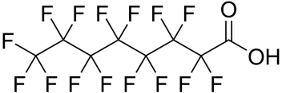
PFAS: A Unique Challenge
Poly- and perfluoroalkyl Substances
Family of thousands of compounds
Extremely stable – heat & stain resistant, water repellant
“Forever chemicals” - persistent, do not biodegrade
Water Soluble
Notes:
What are PFAS? Class of chemicals, family of thousands.
Resistant to heat, highly repellant. Highly durable – attractive for manufacturing but don’t break down in the environment and levels accumulate in people.
Some PFAS bioaccumulate, and they don’t degrade.
Dissolve in water

Slide 9
MassDEP Priority PFAS Activities
SCIENTIFIC RESEARCH & HEALTH ADVISORIES
Targeted monitoring of public water supplies
Testing wastewater, residuals, riverine waters, new water supply sources
Cleanup standard regulations
Drinking Water standard
EXTENSIVE MONITORING
Notes:
DEP has many important programs, but our responsibility to protect public drinking water may be the agency’s most critical mission. That has been our priority.
Office of Research and Standards Guidance – ORS established a Health Advisory for DW in 6/2018 of 70 ppt for sum of 5 PFAS. Action we can take quickly, prior to regulation and water suppliers comply. Updated the HA to be significantly more conservative and added a 6th compound. 2 included in EPA’s HA + two more that share similar chemical structures and are likely to exhibit similar toxic qualities.
Recently finalized DW standard based on sum of 6 w/ limit of 20 ppt. Monitoring requirements.
MCP – regulations for clean up of hazardous waste sites. Standards for soil and groundwater clean-up in place as of 12/2019 (many water supply sources are groundwater in MA). Based on limit of 20 ppt for sum of 6 PFAS.
Monitoring – where is PFAS contamination, what levels? Last year, targeted sampling around areas where we find PFAS to identify full extent. Earlier “targeted” monitoring focused on areas of likely contamination (i.e. use of AFFF)
Currently offering free sampling analysis to PWS. Sampling required under MCL, phased in beginning in January.
Firefighting Foam Take-Back Program - 200,000 pounds collected for safe disposal
New public water supplies – often new groundwater wells – testing for PFAS as part of oversight for approving them, before they go online.

Slide 10
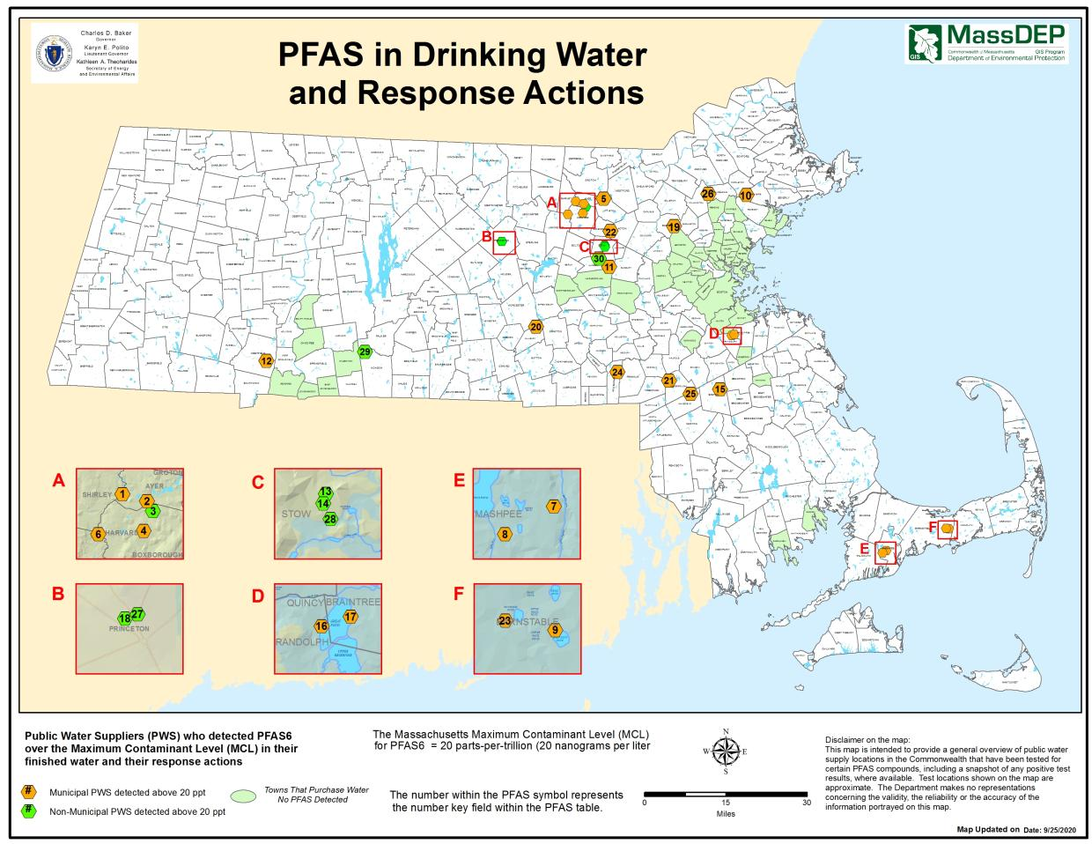
Notes:
30 systems (as of 9-25-2020) overall w/ detections above limit. Some are smaller systems like condo associations. We work with them to figure out an immediate solution – eg take the contaminated source off-line, interconnection, notify customers and worst case – provide bottled water (Devens). Many then put treatment in place over time.
Those currently above 20 ppt include:
5 Community PWS
3 NTNCs
3 TNCs (not subject to the MCL)
Treatment: Hyannis (JBCC), Westfield (Barnes), Devens (Superfund), Ayer. All from military installations, use of firefighting foam. Advocated to federal military to take responsibility and pay – won’t do it w/o standards, federal. Problem is towns need treatment in the meantime, pay for it, military won’t reimburse.
Hudson has treatment – manufacturer PRP (Precision Coatings)
Stow – muni firefighting is at least partly the source, Ayer – smaller systems, Mashpee, Braintree – treatment in process.
As for the Easton/Randolph/Foxboro/Braintree question... No know source. SERO is doing source discovery activities (RFIs, sampling) to figure that out. For that matter, we still don't know where the Hudson Chestnut St wellfield contamination is coming from.

Slide 11
PFAS6 Drinking Water Standard
Regulations establish a new Maximum Contaminant Level (MCL): highest level of a contaminant allowed in drinking water. MCLs are enforceable standards
“PFAS6” MCL is 20 ppt for the sum of six PFAS
Based on MassDEP’s Office of Research and Standards assessment of toxicology information. Reviewed and endorsed by MassDEP Health Effects Advisory Committee

Slide 12
New Resources to Address PFAS
Legislative Funding Allocation
Public & Private Water Supply Testing
Grants for Design of Drinking Water Treatment
Funding - 0% interest loans for treatment. $20 million in funding. Governor’s ARPA Proposal.
Notes:
Mentioned B-P Administration – sought and received 28m in new funding from the Legislature. Here’s what we’re doing with it.
Free testing for Public Water Supplies statewide. Some testing of Pvt Wells – goal is to determine and characterize PFAS contamination in 69 communities without large public water suppliers. Work w/ BOH, seek volunteers for well testing, figure out how many wells to test in a community. IN proximity to known/suspected contamination or NOT – in order to see if it shows up where we don’t expect it.
PWS testing going on now. Started private wells, on hold due to COVID. 211 Public Water Systems (PWS) signed up for DEP’s free lab analyses
132 of these have been sampled or are in the process, including 17 of 25 largest PWS
Paying for treatment is daunting for many communities – 5-15 million. New program to help get started – funding for design of treatment. Up to 200k per grant, total of $2m awarded, round 2 coming. Reimbursement eligible for communities who have already done treatment design.
State Revolving Fund – water infr. Loans – new funding to provide zero interest loans. Additional 20m (capitalized can support loans worth exponentially more).
Supplemental Budget (Chapter 142 of the Acts of 2019, Chapter 31 of the Acts of 2020)
8.4m (2m for grants)
For the testing of potential per- and polyfluoroalkyl substances (PFAS) contamination of water supplies and for grants to support treatment and design of affected drinking water systems; provided, that nothing in this item shall preclude PFAS impacted communities from seeking reimbursement for costs and expenses already incurred for testing potentially contaminated water supplies and the treatment and design of affected drinking water systems related to PFAS contamination; and provided further, that any unexpended funds in this item shall not revert but shall be made available for the purpose of this item until June 30, 2021………$4,200,000
CWT PFAS
Lines: 598-601
Line Item: 1595-1200
Amount: $10,650,000
Same As: All (-$)
For an operating transfer to the Massachusetts Clean Water Trust to support drinking water programs to remediate per- and polyfluoroalkyl substances (PFAS) contamination of public water supplies, including, but not limited to, no-interest loans…$10,650,000
CWT GENERAL
Lines: 602-604
Line Item: 1595-1205
Amount: $9,050,000
Same As: All (-$)
For an operating transfer to the Massachusetts Clean Water Trust to support its purposes as set forth in chapter 29C of the General Laws, including to increase project capacity….$9,050,000

Slide 13
PFAS6 Drinking Water Standard
Public Water Suppliers
Currently there are 1,618 active PWS in the State of which 1,467 are required to test for PFAS (have their own water source)
311 Community PWS have tested their water for PFAS. The remaining 137 small Community PWS are required to test this month.
811 PWS have signed up for free sampling
Private well sampling
Meetings are held with town and state officials in the 84 selected communities with > 60% residents served by private wells. Outreach is done via postcards and social media.
2,782 homeowners have applied for the free sampling from the 84 towns.
845 homeowners are now sampling/have sampled. This number includes all who have been sent sampling kits.
We have results from 727 private wells; 94.8% are below the MCL.
3 private wells have tested with results above the 90 ppt imminent hazard

Slide 14
PFAS6 Drinking Water Standard
Grants/Loans for PWS
15 PFAS construction projects and one planning project are being financed with 0% interest loans through the Clean Water Trust/MassDEP.
$5 million in grants were awarded to 26 PWS for the planning and design of PFAS treatment systems.
19 applications from PWS for the Interim PFAS Response Grant Program are under review. $2 million in funding is available in multiple rounds. Round 2, will be announced later in the Fall.
ARPA Funding
Governor’s Proposal would allocate funds to projects addressing PFAS

Slide 15
PFAS
Federal “Roadmap” Announced 10/18
Participation in Legislative Task Force
Ongoing work with “Residuals”
NPDES Wastewater Testing
Surface Water Testing
Notes:
Now talking about what we’re focusing on today – PFAS and Wastewater. A few points as relevant context – situational, constraints under which we are making policy decisions.
MA not delegated, so EPA is the lead and writes permits for entities covered by NPDES permits such as wastewater treatment plants. AND another change happened in June – end of longstanding joint permitting agreement between DEP and EPA R1. Now DEP and EPA issue separate permits, though we are seeking to work closely together and minimize duplicative requirements for permittees. AND EPA is requiring us to provide the WQC, affirming the permit meets our state SWQS earlier in the process, so we are now doing that before federal permit is final. As a result, permittees are getting the cert before permit (worst case we would have to reissue if permit changes). (DEP reviews the permits, offers input. EPA is the ultimate decider of permit terms).
Laboratory method for sampling – EPA is developing a methodology that would provide consistent approach. Until it is completed, states have to develop a method, which is time consuming or do what we’re doing which is to review individual labs’ methods and approve them.
One legal authority EPA has for regulating something in wastewater is through Natl Effluent guidelines – basically a national water quality standard for PFAS needed, could be used to include a limit in permits. Takes field work and research. EPA not pursuing this.
Leaves states to develop their own SWQS, which can then be reflected in NPDES permits in each specific state.
SWQS– NH and VT have decided it is not prudent to develop these standards on their own. Would require studies of PFAS absorption in fish tissues. WQS to protect aquatic health could be expensive and time consuming but those based on drinking water (public health) could be based on the MCL (more simple).
We are years away from having a specific PFAS SWQS here in MA and when we develop one, there will be consultation and public process.

Slide 16
Sewer Overflow Notification Law
New Statute signed into Law January 2021
Addresses Combined Sewer Overflow (CSO) issues in rivers
establishes requirements and procedures for notifying the public of sewage discharges and overflows into the surface waters of the Commonwealth
Dischargers will be required to notify the public of discharges of certain types of untreated or partially treated wastewater, including discharges that fall into the categories of CSOs, sanitary sewer overflows (SSOs), and blended wastewater.
MassDEP must maintain statewide database and develop regulations by January, 2022; effective summer 2022.
Notes:
Here’s what we are doing through requirements in DRAFT NPDES permits that have been issued since the summer.
The requirement is to conduct monitoring and gather other data to help characterize and identify the presence of PFAS in wastewater. Included in permits beginning in XXX June 2020. so far, 14 issued. Will talk more about the requirements in a minute.
Requirement to collect samples. NOT AN EFFLUENT LIMIT. NOT A TREATMENT REQUIREMENT.
EXPLAIN OTA
WHAT TO SAY ABOUT USGS SAMPLING
While EPA agreed to include conditions in NPDES permits that come out of Region 1, that didn’t cover MSGP. Requested that EPA add annual PFAS effluent monitoring for several industrial sectors in Multi-Sector General Permit (MSGP) for Stormwater from Industrial Activities

Slide 17
Sewer Overflow Notification Law
Requires notifications to be issued within two hours of the discovery of discharge, and specify which notices must go to specific local, state, and federal government agencies, news organizations, and any individual who has subscribed to receive such notifications.
The regulation will also require municipal boards of health or health departments to issue public health warnings under certain circumstances.
The proposed regulation, a summary of the regulation, and a Note to Reviewers are available on MassDEP’s website: https://www.mass.gov/regulations/314-CMR-1600-notification-requirements-to-promote-public-awareness-of-sewage-pollution The public comment period began October 4, 2021 and ends on November 8, 2021.
Notes:
Here’s what we are doing through requirements in DRAFT NPDES permits that have been issued since the summer.
The requirement is to conduct monitoring and gather other data to help characterize and identify the presence of PFAS in wastewater. Included in permits beginning in XXX June 2020. so far, 14 issued. Will talk more about the requirements in a minute.
Requirement to collect samples. NOT AN EFFLUENT LIMIT. NOT A TREATMENT REQUIREMENT.
EXPLAIN OTA
WHAT TO SAY ABOUT USGS SAMPLING
While EPA agreed to include conditions in NPDES permits that come out of Region 1, that didn’t cover MSGP. Requested that EPA add annual PFAS effluent monitoring for several industrial sectors in Multi-Sector General Permit (MSGP) for Stormwater from Industrial Activities

Slide 18
Thank You and Questions
Notes:
Here’s what we are doing through requirements in DRAFT NPDES permits that have been issued since the summer.
The requirement is to conduct monitoring and gather other data to help characterize and identify the presence of PFAS in wastewater. Included in permits beginning in XXX June 2020. so far, 14 issued. Will talk more about the requirements in a minute.
Requirement to collect samples. NOT AN EFFLUENT LIMIT. NOT A TREATMENT REQUIREMENT.
EXPLAIN OTA
WHAT TO SAY ABOUT USGS SAMPLING
While EPA agreed to include conditions in NPDES permits that come out of Region 1, that didn’t cover MSGP. Requested that EPA add annual PFAS effluent monitoring for several industrial sectors in Multi-Sector General Permit (MSGP) for Stormwater from Industrial Activities

