Slide 1
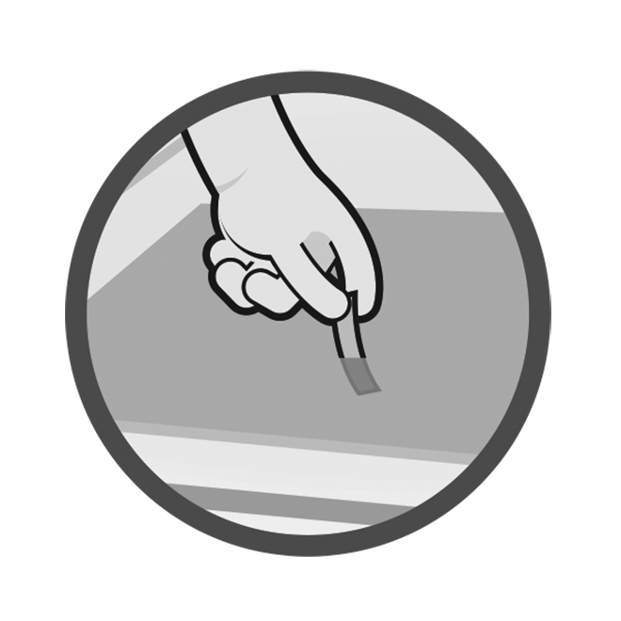
Sanitization for Food Safety
CHOSING THE RIGHT SANITIZER TEST STRIP
Robert Lynch
Director of Sales and Technical Services
Micro Essential Laboratory
rob@microessentiallab.com
718-928-2913
Notes:
Welcome to Sanitization for Food Safety, on using sanitizer test kits! I am your instructor, ____________________.
Provide background information on who you are, where you are from, and why you are here.
First, I’d like to point out a few things:
1. Participant guide: Yours to keep, take notes, draw, doodle; includes course slides, a chart on choosing the correct sanitizer test kit, step-by-step instructions with images on using test kits, and Food Code references pointing out requirements for testing.
2. Parking lot: Large paper on the wall on which I will write down any questions you might have on a topic we are not currently covering; any questions I might not be able to answer so I can look up the answer for you; basically anything we can cover after the presentation, and don’t want to forget.
3. Practice stations: At the back of the room; practice what you learn here today for muscle memory; please remember, sanitizer is a potentially harmful chemical, so no horseplay.
4. Schedule: This is going to be approximately a 45 minute to one hour presentation, but I will stick around for another 10-15 minutes if you have any questions.
Before we look at the purpose behind bring you all here today, I’d like to share with you a quote that I found on an Amazon review of a product regarding the use of sanitizer test kits:
“Used at a restaurant. It’s great. We no longer “use” them, just have it around for the health inspector.”

Slide 2
Cleaning and Sanitizing
Cleaning-the removal of dirt, food, or other soil from a surface, usually accomplished by a detergent
Sanitizing-the removal of pathogens to a safe level, defined as a 5-log reduction, or removal of 99.999% of organisms.
Sanitizing only works when it follows
proper cleaning!!
Notes:
Before we can talk about WHAT it is we’re trying to accomplish, we need to make sure that everyone understands the terminology associated with food safety sanitization. This will be review for many of you, yet correct definitions are important in our discussion.
Cleaning and sanitizing are two very important, and very different, terms that are used in food safety.
Cleaning refers to the removal of dirt, food, or other soil from a surface, usually accomplished by a detergent.
Sanitizing refers to the removal of pathogens to a safe level, defined as a 5-log reduction, or removal of 99.999% of organisms. Cleaning alone is not sufficient for food contact surfaces, and sanitizing only works when it follows proper cleaning.
What other terms are important when discussing food safety sanitization?
If the participants seem knowledgeable in the terms, the next page can be read to them as fill-in-the-blank for more interaction and/or to keep them engaged.

Slide 3
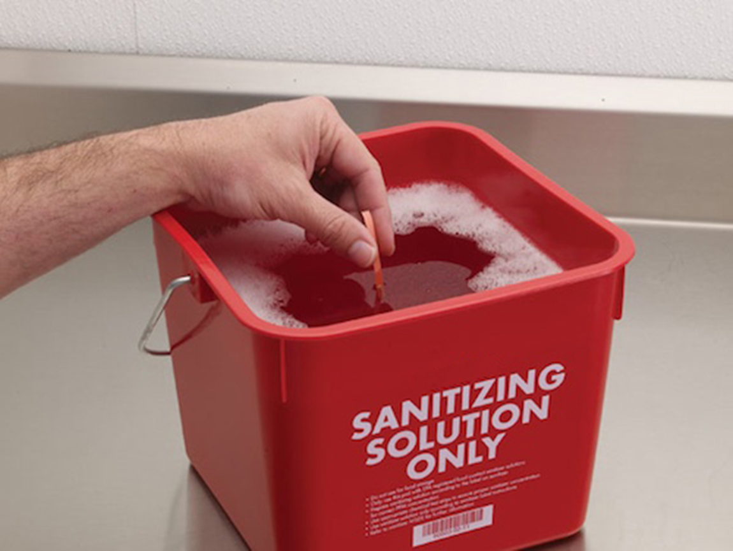
So, what are test kits used for…
Test kits are used to determine the concentration of your sanitizer chemical to insure proper sanitizer dilutions.
Why are we using them…
Chemical manufacturers are required by EPA registration to have a certain concentration to do the job they are expected to do
Too Little chemical and they are not sanitizing
Too much chemical they are cross contaminating with chemical
Notes:
Here’s a quick outline for our course. Today, we are going to discuss the who, what, where, why, when, and how of using sanitizer test kits.
The WHO is who we are, who you are, and who are we trying to help.
The WHY - WHY are we concerned about learning how to properly use sanitizer test kits anyway?
The WHAT will cover basic terms, what test kits to use, and talk about actually what it is that you’ll need to test.
The WHERE will provide a look at the locations and/or facilities that might require testing sanitizer solutions.
The WHEN will cover how often it is necessary to test, as well as discuss any potential differences in frequency between different sanitizer solutions or test kits.
Finally, the HOW. Just HOW do we use these test kits correctly? And have we really been doing it wrong the whole time? The answer to that is, we hope, no, but surprisingly more often than not, yes.
We’ll end the class with some hands-on practice and a quick assessment.
Sound good?
Before we begin - why are you here? Why did your boss, or regulator, or co-worker drag you to this training?
The overall goal of this training program – the reason you are here today – is to help you understand that correct sanitizer concentrations help keep people safe by minimizing microbial food safety hazards. Proper testing can prevent foodborne illness and protect people’s health. Hopefully, you will also learn something new.

Slide 4
So, what is a restaurants motivation to use it…
Besides being a part of the health code, what will make a food service establishment use it regularly…
Contain Chemical costs by using the correct amount
Ensure the safety of customer and staff
Make sure they are not contaminating their food with chemical taste
One less violation on food safety inspection
Keep out of the NEWS!...Chipotle
Notes:
Here’s a quick outline for our course. Today, we are going to discuss the who, what, where, why, when, and how of using sanitizer test kits.
The WHO is who we are, who you are, and who are we trying to help.
The WHY - WHY are we concerned about learning how to properly use sanitizer test kits anyway?
The WHAT will cover basic terms, what test kits to use, and talk about actually what it is that you’ll need to test.
The WHERE will provide a look at the locations and/or facilities that might require testing sanitizer solutions.
The WHEN will cover how often it is necessary to test, as well as discuss any potential differences in frequency between different sanitizer solutions or test kits.
Finally, the HOW. Just HOW do we use these test kits correctly? And have we really been doing it wrong the whole time? The answer to that is, we hope, no, but surprisingly more often than not, yes.
We’ll end the class with some hands-on practice and a quick assessment.
Sound good?
Before we begin - why are you here? Why did your boss, or regulator, or co-worker drag you to this training?
The overall goal of this training program – the reason you are here today – is to help you understand that correct sanitizer concentrations help keep people safe by minimizing microbial food safety hazards. Proper testing can prevent foodborne illness and protect people’s health. Hopefully, you will also learn something new.

Slide 5
Chipotle Avoidable Food Borne Illness
Untreated produce
Cross contamination
Poor food handling practices.
No restaurant wants to be in the news for causing illness …Ensure the safety of customer and staff
Notes:
Here’s a quick outline for our course. Today, we are going to discuss the who, what, where, why, when, and how of using sanitizer test kits.
The WHO is who we are, who you are, and who are we trying to help.
The WHY - WHY are we concerned about learning how to properly use sanitizer test kits anyway?
The WHAT will cover basic terms, what test kits to use, and talk about actually what it is that you’ll need to test.
The WHERE will provide a look at the locations and/or facilities that might require testing sanitizer solutions.
The WHEN will cover how often it is necessary to test, as well as discuss any potential differences in frequency between different sanitizer solutions or test kits.
Finally, the HOW. Just HOW do we use these test kits correctly? And have we really been doing it wrong the whole time? The answer to that is, we hope, no, but surprisingly more often than not, yes.
We’ll end the class with some hands-on practice and a quick assessment.
Sound good?
Before we begin - why are you here? Why did your boss, or regulator, or co-worker drag you to this training?
The overall goal of this training program – the reason you are here today – is to help you understand that correct sanitizer concentrations help keep people safe by minimizing microbial food safety hazards. Proper testing can prevent foodborne illness and protect people’s health. Hopefully, you will also learn something new.

Slide 6
What are they doing now?
Treat produce with PAA
Strong sanitization procedures
Approved sanitizers
Testing to ensure proper dilution
Logging of tests to ensure compliance
Notes:
Here’s a quick outline for our course. Today, we are going to discuss the who, what, where, why, when, and how of using sanitizer test kits.
The WHO is who we are, who you are, and who are we trying to help.
The WHY - WHY are we concerned about learning how to properly use sanitizer test kits anyway?
The WHAT will cover basic terms, what test kits to use, and talk about actually what it is that you’ll need to test.
The WHERE will provide a look at the locations and/or facilities that might require testing sanitizer solutions.
The WHEN will cover how often it is necessary to test, as well as discuss any potential differences in frequency between different sanitizer solutions or test kits.
Finally, the HOW. Just HOW do we use these test kits correctly? And have we really been doing it wrong the whole time? The answer to that is, we hope, no, but surprisingly more often than not, yes.
We’ll end the class with some hands-on practice and a quick assessment.
Sound good?
Before we begin - why are you here? Why did your boss, or regulator, or co-worker drag you to this training?
The overall goal of this training program – the reason you are here today – is to help you understand that correct sanitizer concentrations help keep people safe by minimizing microbial food safety hazards. Proper testing can prevent foodborne illness and protect people’s health. Hopefully, you will also learn something new.

Slide 7
So, what is a restaurants motivation to use it…
Besides being a part of the health code, what will make a food service establishment use it regularly…
Contain Chemical costs by using the correct amount
Ensure the safety of customer and staff
Make sure they are not contaminating their food with chemical taste
One less violation on food safety inspection
Notes:
Here’s a quick outline for our course. Today, we are going to discuss the who, what, where, why, when, and how of using sanitizer test kits.
The WHO is who we are, who you are, and who are we trying to help.
The WHY - WHY are we concerned about learning how to properly use sanitizer test kits anyway?
The WHAT will cover basic terms, what test kits to use, and talk about actually what it is that you’ll need to test.
The WHERE will provide a look at the locations and/or facilities that might require testing sanitizer solutions.
The WHEN will cover how often it is necessary to test, as well as discuss any potential differences in frequency between different sanitizer solutions or test kits.
Finally, the HOW. Just HOW do we use these test kits correctly? And have we really been doing it wrong the whole time? The answer to that is, we hope, no, but surprisingly more often than not, yes.
We’ll end the class with some hands-on practice and a quick assessment.
Sound good?
Before we begin - why are you here? Why did your boss, or regulator, or co-worker drag you to this training?
The overall goal of this training program – the reason you are here today – is to help you understand that correct sanitizer concentrations help keep people safe by minimizing microbial food safety hazards. Proper testing can prevent foodborne illness and protect people’s health. Hopefully, you will also learn something new.

Slide 8
Food Handler Safety Training
ServSafe
NEHA
Paster
Public Offerings
Notes:
Here’s a quick outline for our course. Today, we are going to discuss the who, what, where, why, when, and how of using sanitizer test kits.
The WHO is who we are, who you are, and who are we trying to help.
The WHY - WHY are we concerned about learning how to properly use sanitizer test kits anyway?
The WHAT will cover basic terms, what test kits to use, and talk about actually what it is that you’ll need to test.
The WHERE will provide a look at the locations and/or facilities that might require testing sanitizer solutions.
The WHEN will cover how often it is necessary to test, as well as discuss any potential differences in frequency between different sanitizer solutions or test kits.
Finally, the HOW. Just HOW do we use these test kits correctly? And have we really been doing it wrong the whole time? The answer to that is, we hope, no, but surprisingly more often than not, yes.
We’ll end the class with some hands-on practice and a quick assessment.
Sound good?
Before we begin - why are you here? Why did your boss, or regulator, or co-worker drag you to this training?
The overall goal of this training program – the reason you are here today – is to help you understand that correct sanitizer concentrations help keep people safe by minimizing microbial food safety hazards. Proper testing can prevent foodborne illness and protect people’s health. Hopefully, you will also learn something new.

Slide 9
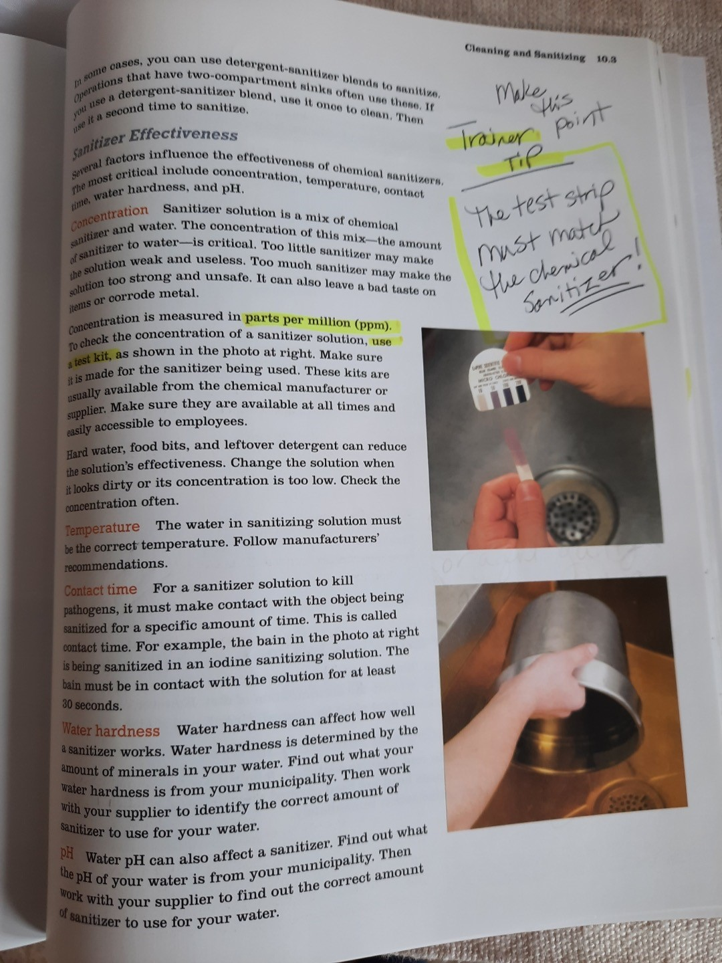
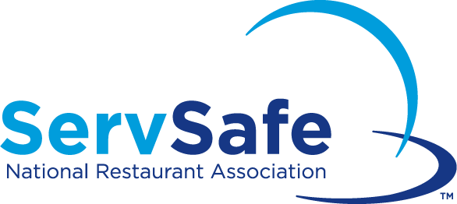
What “test Kit” training do restaurant food handlers get?
In the Serv Safe Manager Training Book, they are told…
“Use a Test Kit”
Notes:
These are photos of just some of the people, associated with only one Website, StopFoodborneIllness.org, who have been affected by foodborne illness. This clearly represents that foodborne illness doesn’t discriminate on the basis of age, color, or gender. It can happen to anyone.
Has anyone here been involved with a foodborne illness case that resulted in a serious illness, or even death? What was the cause of the FBI? Could something have been done at the retail level to prevent the illness? Did it involve sanitization?
The goal here is to set the tone for the seriousness of FBIs in retail facilities and understand the PURPOSE for this training. If the participants have sufficient examples to share, that is the best scenario. If not, show the following 5 minute video.
This is why you all are here today – to understand that sanitizers and testing are crucial for keeping people safe. Someone needs to communicate the seriousness of improper sanitizer testing to the food facilities, and show them how to do it correctly.

Slide 10
How does a food service establishment pick the proper test kit…
Picking the proper test kit
Does chemical supplier provide it with order
See if wall poster has information on test kit
Assign lead kitchen worker to learn use
and be responsible to train staff
Hope the regulator that visits is willing to help them understand use of
test kits
Notes:
Here’s a quick outline for our course. Today, we are going to discuss the who, what, where, why, when, and how of using sanitizer test kits.
The WHO is who we are, who you are, and who are we trying to help.
The WHY - WHY are we concerned about learning how to properly use sanitizer test kits anyway?
The WHAT will cover basic terms, what test kits to use, and talk about actually what it is that you’ll need to test.
The WHERE will provide a look at the locations and/or facilities that might require testing sanitizer solutions.
The WHEN will cover how often it is necessary to test, as well as discuss any potential differences in frequency between different sanitizer solutions or test kits.
Finally, the HOW. Just HOW do we use these test kits correctly? And have we really been doing it wrong the whole time? The answer to that is, we hope, no, but surprisingly more often than not, yes.
We’ll end the class with some hands-on practice and a quick assessment.
Sound good?
Before we begin - why are you here? Why did your boss, or regulator, or co-worker drag you to this training?
The overall goal of this training program – the reason you are here today – is to help you understand that correct sanitizer concentrations help keep people safe by minimizing microbial food safety hazards. Proper testing can prevent foodborne illness and protect people’s health. Hopefully, you will also learn something new.

Slide 11
Tools Available
Us: Micro Essential Laboratory, Inc..
Training videos online
Phone support
The Regulator - Federal, State, Local
Industry – Chemical manufacturers
Janitorial Products Distributors
Notes:
So, who are we, who are you, and who are we trying to help?
WHO are we, anyway, that we can talk to you about sanitizer test kits?
As I mentioned, my name is ___________________. Discuss your relationship with Micro Essential. This course is sponsored by Micro Essential Laboratory, Incorporated. Micro Essential Laboratory has been around since 1934 and is the leading manufacturer of sanitizer test paper used throughout the foodservice industry. They currently provide pH strips, sanitizer test papers, and pH buffer standards, along with various specialty test papers, to a global market.
And you know WHO you are - you are the health inspectors and regulators who we thought would be the best “in” to the front lines of food safety. We are obviously not able to visit every food establishment out there to ensure that people are using test kits correctly, but that is where you come in; that is part of what you already do when visiting a food establishment. As we already determined, not everyone in restaurants, retail, etc. knows how to use the test correctly, so we would like you to be comfortable enough to show them how to use it correctly. Ask the participants if anyone has any sanitization inspection stories to share with the class. Finding a sanitizer solution that had a concentration way off base? A cleaning bucket that actually didn’t contain any sanitizer? Employees who didn’t know where the test kit was, or worse, what a test kit was?
And WHO are we trying to help? The food establishment manager, the employee who is using that sanitizing solution to protect the public from foodborne illness, or any pathogens that might cause harm. Ultimately, through training, we’re all trying to protect the public.

Slide 13
Picking a test kit…
TEST KITS
QT-10, or “Quat Test – 10” is formulated for 2-chain quat compounds with measurements in the range of 0 - 400ppm.
QT-40 is a quat test paper for 4-chain quats with measurements of 0 - 500ppm.
QAC is a general, non-specific match to test for all quats.
Chlorine test papers provide a means to measure the concentration of free available chlorine in solution. Measurements range from 10 - 200ppm.
Notes:
If the effectiveness of chemical sanitizers is determined primarily by the concentration and pH of the sanitizer solution, and those values can vary, a test kit is necessary to accurately determine the concentration of the chemical sanitizer solution.
And, there are different sanitizing test kits for the various chemical sanitizers.
Read the slide #1, 2 & 3
QAC test strips are not calibrated precisely to specific quat chemistries as the first two are.
Read the slide #4

Slide 14
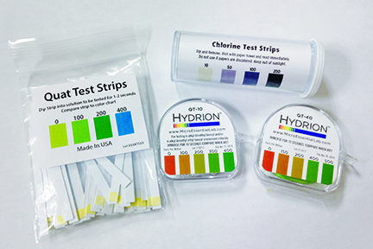
Commonly seen test kits
Notes:
Ensure the facility has the correct kit for their sanitizer solution(s). Test kits are not interchangeable. Also, kits can expire - so be sure to check the date on the dispenser as well.
Pass around sample test kits and ask participants to describe how they would ensure the kit is being used. Has it been opened at all? Stored in locked drawer? Did the manager / employee know how to use it?
Let’s assume that you ask to see a facility’s test kits and you receive a kit that resembles one of those being passed around the room.
What can you discern by looking at these kits?
Example rolls on next 4 slides
In this slide: chlorine, QT-10, QT-40, QAC

Slide 15
Importance of Sanitarians
Sanitarians have tremendous influence on local food safety.
Sanitarians refresh the knowledge of food handlers.
Sanitarians carry authority, both based on your position and on the training the public knows you have.
Notes:
So, who are we, who are you, and who are we trying to help?
WHO are we, anyway, that we can talk to you about sanitizer test kits?
As I mentioned, my name is ___________________. Discuss your relationship with Micro Essential. This course is sponsored by Micro Essential Laboratory, Incorporated. Micro Essential Laboratory has been around since 1934 and is the leading manufacturer of sanitizer test paper used throughout the foodservice industry. They currently provide pH strips, sanitizer test papers, and pH buffer standards, along with various specialty test papers, to a global market.
And you know WHO you are - you are the health inspectors and regulators who we thought would be the best “in” to the front lines of food safety. We are obviously not able to visit every food establishment out there to ensure that people are using test kits correctly, but that is where you come in; that is part of what you already do when visiting a food establishment. As we already determined, not everyone in restaurants, retail, etc. knows how to use the test correctly, so we would like you to be comfortable enough to show them how to use it correctly. Ask the participants if anyone has any sanitization inspection stories to share with the class. Finding a sanitizer solution that had a concentration way off base? A cleaning bucket that actually didn’t contain any sanitizer? Employees who didn’t know where the test kit was, or worse, what a test kit was?
And WHO are we trying to help? The food establishment manager, the employee who is using that sanitizing solution to protect the public from foodborne illness, or any pathogens that might cause harm. Ultimately, through training, we’re all trying to protect the public.

Slide 16
Tools Available for Regulators
Us: Micro Essential Laboratory, Inc..
https://www.youtube.com/embed/SHBCMfk-bfo
www.healthinspectorfaq.com
Regulator associations (MEHA, NEHA, CASA, etc.)
Industry – Chemical Manufacturers
Notes:
So, who are we, who are you, and who are we trying to help?
WHO are we, anyway, that we can talk to you about sanitizer test kits?
As I mentioned, my name is ___________________. Discuss your relationship with Micro Essential. This course is sponsored by Micro Essential Laboratory, Incorporated. Micro Essential Laboratory has been around since 1934 and is the leading manufacturer of sanitizer test paper used throughout the foodservice industry. They currently provide pH strips, sanitizer test papers, and pH buffer standards, along with various specialty test papers, to a global market.
And you know WHO you are - you are the health inspectors and regulators who we thought would be the best “in” to the front lines of food safety. We are obviously not able to visit every food establishment out there to ensure that people are using test kits correctly, but that is where you come in; that is part of what you already do when visiting a food establishment. As we already determined, not everyone in restaurants, retail, etc. knows how to use the test correctly, so we would like you to be comfortable enough to show them how to use it correctly. Ask the participants if anyone has any sanitization inspection stories to share with the class. Finding a sanitizer solution that had a concentration way off base? A cleaning bucket that actually didn’t contain any sanitizer? Employees who didn’t know where the test kit was, or worse, what a test kit was?
And WHO are we trying to help? The food establishment manager, the employee who is using that sanitizing solution to protect the public from foodborne illness, or any pathogens that might cause harm. Ultimately, through training, we’re all trying to protect the public.

Slide 17
Most Common Test Kit Use Errors
Just not using it (still wrapped in foil as they just finished their last test…)
For Quat, Swishing the test strip
For Quat, not keeping test paper in solution for 10 seconds
Not blotting chlorine test paper
Notes:
So, who are we, who are you, and who are we trying to help?
WHO are we, anyway, that we can talk to you about sanitizer test kits?
As I mentioned, my name is ___________________. Discuss your relationship with Micro Essential. This course is sponsored by Micro Essential Laboratory, Incorporated. Micro Essential Laboratory has been around since 1934 and is the leading manufacturer of sanitizer test paper used throughout the foodservice industry. They currently provide pH strips, sanitizer test papers, and pH buffer standards, along with various specialty test papers, to a global market.
And you know WHO you are - you are the health inspectors and regulators who we thought would be the best “in” to the front lines of food safety. We are obviously not able to visit every food establishment out there to ensure that people are using test kits correctly, but that is where you come in; that is part of what you already do when visiting a food establishment. As we already determined, not everyone in restaurants, retail, etc. knows how to use the test correctly, so we would like you to be comfortable enough to show them how to use it correctly. Ask the participants if anyone has any sanitization inspection stories to share with the class. Finding a sanitizer solution that had a concentration way off base? A cleaning bucket that actually didn’t contain any sanitizer? Employees who didn’t know where the test kit was, or worse, what a test kit was?
And WHO are we trying to help? The food establishment manager, the employee who is using that sanitizing solution to protect the public from foodborne illness, or any pathogens that might cause harm. Ultimately, through training, we’re all trying to protect the public.

Slide 18
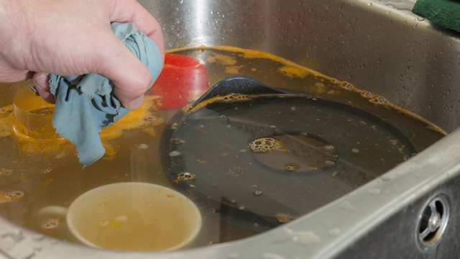
What you don’t want to see…
Notes:
And this lovely 3-compartment sink? Sink sanitizer solutions should be changed every four hours - or as needed if the water becomes soiled.
Facilities must monitor, test, and change sanitizer solutions to ensure the proper concentration at all times, per manufacturer’s recommendation.

Slide 19
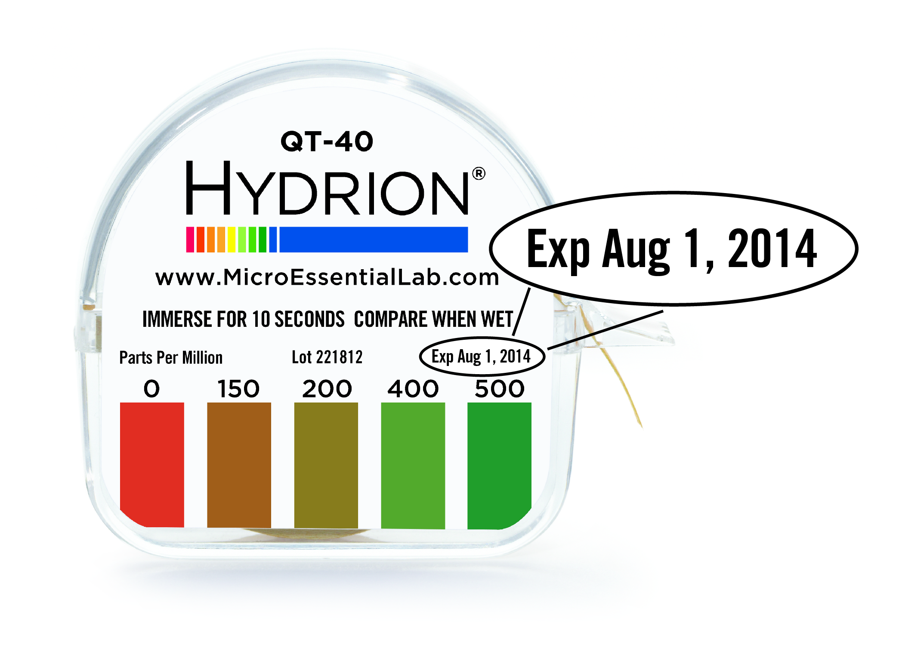
Does it expire?
Notes:
Make sure participants catch the following examples of “bad” test kits shown on the next 4 slides.
1. This is an example of an expired kit. Expired kits should be thrown away.

Slide 20
How to know they aren’t using it…
Notes:
3. Here is a new kit - still wrapped in foil. If this is presented as the active kit, they likely aren’t testing.
At 180 inches, there is little likelihood that they are actually just starting a new roll.

Slide 21
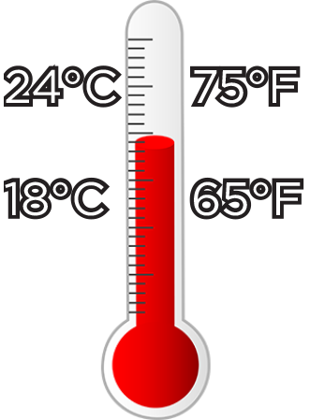
Temperature for testing Quats
Notes:
Let’s start with quats.
First review the directions:
Does the sanitizer require a specific water temperature?
The general recommendation for quats is to be tested at room temperature, 65°F-75°F (18°C-24°C).
Use a pre-cut test strip, or tear off approximately 2 inches of the roll of test paper.

Slide 22
No testing bubbles!
No swishing the strip around!
Notes:
Quats will often foam when filling a sink or bucket with solution. Avoid testing the foam by either testing a clear area or letting the foam dissipate prior to testing.
The foam has a higher concentration of sanitizer and therefore gives incorrect results.
NO swishing either! Again, it will force chemical into the strip and give a false high reading or give a modeled affect to variable uptake of the sanitizer.

Slide 23
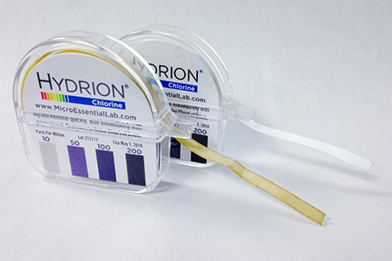
What is wrong with this…
Notes:
4. What about these?
What is wrong with the roll in front? Damaged or contaminated kit
What can cause this? Oxidation by exposure to air, humidity, or chemical fumes
The first kit has likely been exposed to the air, humidity or chlorine gas for too long. If you see a test paper roll that resembles the roll in front, you can be pretty safe in assuming it is NOT being used in the facility.
Can anything be done with that roll? Dispose of the roll. May tear-off 2 inches after end of oxidation, if possible, to still use.

Slide 24
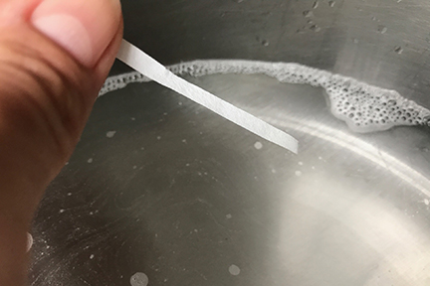
Chlorine testing at room temperature
Notes:
Testing chlorine solution is only slightly different.
First? Review the directions.
Does the sanitizer require a specific water temperature?
As we saw in the table earlier, the minimum temperatures for chlorine solutions can vary based on the pH of the solution.
Room temperature, 65°F-75°F (18°C-24°C), is still a safe bet, as are solutions with cooler temperatures. The warmer the water in a chlorine solution, the lower the concentration of available chlorine is needed to show a “sufficient” amount of sanitizer. So, if the water is not too hot, the test will work correctly.

Slide 25
Did you blot the strip?
Notes:
Make sure to read the directions - some chlorine test kits require you to “blot” the strip on a paper towel prior to comparing to the color chart.

Slide 26
A perfect match!
Notes:
Chlorine bleach should be between 50 and 100ppm.
The chemical manufacturer generally determines the concentration for effective sanitization; read the label.

Slide 27
Test Frequency
Buckets= Every 2 to 4 hours or more as needed to keep the water clean and the sanitizer effective in use.
Spray Bottles-1 time/day at minimum
Dishmachines- 1 time/day at minimum
Pre-soaked disposable sanitizer wipes- the bucket should be tested each shift
Notes:
SO – now we can look at the WHEN
WHEN to test –
Buckets should be changed how often…? Every 2-4 hours or more as needed to keep the water clean and the sanitizer effective in use.
What about spray bottles? Dish machines? At least once per day
Also, remember that buckets and spray bottles need to be thoroughly rinsed in-between to prevent the build-up of the chemicals.
Pre-soaked disposable sanitizer wipes should also be tested.

Slide 28
Traditional chemical compounds seen …
Notes:
Federal, state and local health regulations require users of sanitizer solutions to have appropriate test kits available to verify the strength of sanitizer solutions. Note that the regulations DO require the users to USE the test kits, not only have them available. Again, this is where we need you all to help.
Testing kits to measure the concentration of sanitizing solutions are required for 2 reasons:
1. The use of chemical sanitizers requires minimum concentrations of the sanitizer during the final rinse step to ensure proper sanitization. AND
2. Too much sanitizer in the final rinse water could be toxic.
I have found employees will sometimes feel that if the recommended amount of concentrate in a set quantity of water is good, then adding a little more concentrate will make the solution last longer and will work better. Quite the contrary... using a sanitizer solution that is too strong can in fact put customers at risk since too strong a solution will actually contaminate the surface and potentially make the customer sick.
For your reference, a sanitizing solution that is too weak would be a violation of FDA Food Code § 4-501.114. A solution that is too strong would be a violation of § 7-204.11.
What about your local jurisdiction? Does anyone follow regulations different than those from the latest Food Code?

Slide 29
New Chemicals entering the market…
Notes:
Federal, state and local health regulations require users of sanitizer solutions to have appropriate test kits available to verify the strength of sanitizer solutions. Note that the regulations DO require the users to USE the test kits, not only have them available. Again, this is where we need you all to help.
Testing kits to measure the concentration of sanitizing solutions are required for 2 reasons:
1. The use of chemical sanitizers requires minimum concentrations of the sanitizer during the final rinse step to ensure proper sanitization. AND
2. Too much sanitizer in the final rinse water could be toxic.
I have found employees will sometimes feel that if the recommended amount of concentrate in a set quantity of water is good, then adding a little more concentrate will make the solution last longer and will work better. Quite the contrary... using a sanitizer solution that is too strong can in fact put customers at risk since too strong a solution will actually contaminate the surface and potentially make the customer sick.
For your reference, a sanitizing solution that is too weak would be a violation of FDA Food Code § 4-501.114. A solution that is too strong would be a violation of § 7-204.11.
What about your local jurisdiction? Does anyone follow regulations different than those from the latest Food Code?

Slide 30
What are we hearing from the regulators?
New Chemicals being seen in use;
Hypochlorous Acid (HOCL)
Hydrogen Peroxide
Peracetic Acid
High Range Quat solutions and sprays (Lysol)
Disinfecting vs Sanitizing food contact surfaces
Food service establishments think using more chemical is better
Use of RTU products is on the rise, but are these solutions OK to use?

Slide 31
Review
Why are we discussing restaurants???
They receive little to no training on sanitizing and even less on testing
What happens if the person that showed them how to do the test, did the test wrong?
In most small local establishments, they don’t even really know what they are using
Bleach
Quats
2 chain
4 chain
Other newer chemicals
It is a confusing time for regulators on the chemicals, it is even worse for end users
Notes:
Federal, state and local health regulations require users of sanitizer solutions to have appropriate test kits available to verify the strength of sanitizer solutions. Note that the regulations DO require the users to USE the test kits, not only have them available. Again, this is where we need you all to help.
Testing kits to measure the concentration of sanitizing solutions are required for 2 reasons:
1. The use of chemical sanitizers requires minimum concentrations of the sanitizer during the final rinse step to ensure proper sanitization. AND
2. Too much sanitizer in the final rinse water could be toxic.
I have found employees will sometimes feel that if the recommended amount of concentrate in a set quantity of water is good, then adding a little more concentrate will make the solution last longer and will work better. Quite the contrary... using a sanitizer solution that is too strong can in fact put customers at risk since too strong a solution will actually contaminate the surface and potentially make the customer sick.
For your reference, a sanitizing solution that is too weak would be a violation of FDA Food Code § 4-501.114. A solution that is too strong would be a violation of § 7-204.11.
What about your local jurisdiction? Does anyone follow regulations different than those from the latest Food Code?

Slide 32
We thank you for protecting public health!
Rob Lynch
Director of Sales and Technical Services
Micro Essential Laboratory, Inc. 4224 Avenue H • Brooklyn, NY 11210
rob@microessentiallab.com
718-928-2913
Notes:
From all of us at Micro Essential Laboratory, thank you for joining us today and thank you for protecting public health through proper sanitizing!
We hoped you learned something that you are able to take back with you and pass on to those front-line food safety people in the field. We want to help you to help others keep consumers safe.
I’ll be around for a few minutes if you have any other questions.

