Slide 1
Wait, Wait… Can’t Wait!
Local Public Health Crisis Communication

Slide 2
Welcome & Agenda
Panelist Tips
Breakout Groups
Large Group Tip Additions
Crisis Communication Tools
Notes:
Each panelist speaks for 2-3 minutes, sharing their tip and a story that goes with it. (15 minutes total)
Breakout groups (15 minutes total)
Sharing out from breakout groups (10 minutes)
Resources & Wrap-up (5 minutes)

Slide 3
Damon Chaplin, New Bedford
Tip: Long-term relationship building and trust building matter.
BIO: Damon Chaplin has served as Director of the New Bedford Health Department since January 2018. Previously, he was Director of Local Public Health Initiatives and Metro Boston Regional Director at Massachusetts Department of Public Health, as well as Healthy School Inspection Program Manager at the Boston Public Health Commission. A Massachusetts native, he holds an MBA from Curry College and a BA from Central State University in Ohio.

Slide 4
Natasha Waden, Arlington
Tip: Short + Simple = Effective
BIO: Natasha Waden, Public Health Director for the Town of Arlington, has worked in local public health for the past 15 years. She obtained a BS in Health Education from Plymouth State University and a Master’s in Public Administration from Suffolk University.

Slide 5
Roberto Santamaria, Nantucket
Tip: Pictures speak louder than words. A video screams over crowds
  Document, document, document. Most smartphones are now scanners as well. Scan your documents!
  Visual Storytelling helps explain better than most.
BIO: Roberto Santamaria is the Director of Health and Human Services for the Island of Nantucket. With 11 years in the field, Roberto uses his experiences in multiple towns across Massachusetts to inform policy and decisions.

Slide 6
Jayne Smith, Dalton & Alford
Tip: Current business contact lists are an important part of effective crisis communication plan.
BIO: Jayne Smith is a fully credentialed Health Agent for the towns of Alford and Dalton in the wild west of Berkshire County. Jayne has worked in several public health department since returning to MA in 2014, and continues work to advance public health through her involvement in the Southern Berkshire Public Health Collaborative, the SAPHE working group and as the Region 1 Representative for MHOA. Jayne and her family run a small farm in Sheffield, MA where they sell honey, beef and garlic at their roadside farm stand and the farmers’ market.

Slide 7
Kristin Black, Northborough
Tip: Customize your messages for your audience. Email marketing software allows you to create sign-up forms where users can select email lists of interest.
BIO: Kristin Black, PhD, MS is the Health Agent for the Town of Northborough and serves as the shared services coordinator for the Greater Boroughs Partnership for Health. Kristin previously worked for the Uxbridge Board of Health for 5 years and transitioned to Northborough in October of 2020.

Slide 8
Breakout Groups
What other tips should be added to our Local Public Health Crisis Communication list?
What have you found that doesn’t work in your community?
What resources are on your crisis communication wish list?

Slide 9
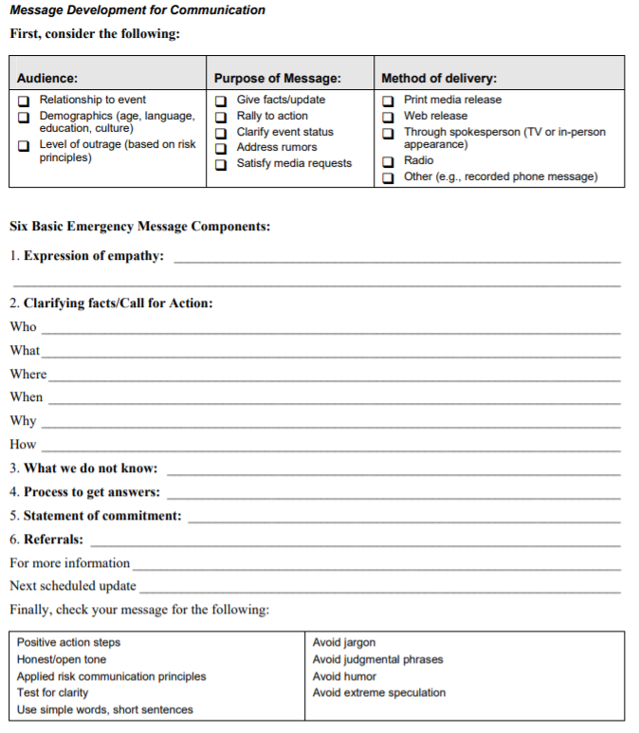
Template tool
https://emergency.cdc.gov/cerc/resources/pdf/message_development_for_communication.pdf

Slide 10
Tools/Resources
CDC Crisis & Emergency Risk Communication: https://emergency.cdc.gov/cerc/index.asp
  Training, templates, plans, disease specific webinars
SAMHSA Communicating in a Crisis: https://store.samhsa.gov/sites/default/files/d7/priv/pep19-01-01-005.pdf
  Good section about developing goals/key messages & sticking with them (starts pg 7)
Local Public Health Institute of Massachusetts: https://sites.bu.edu/masslocalinstitute/2021/06/29/foundations-for-local-public-health-practice-3/
  Foundations course has communication module

Slide 11
Teresa Wood Kett, MPH www.publichealthpost.org
Managing Editor, Public Health Post
Boston University School of Public Health
Subscribe to our Friday Roundup of Stories
https://www.publichealthpost.org/about-us/

